Slide 1



Algorithmic Concepts of Peak Picking # Algorithmische Konzepte für Peak Picking
B
Zhixu Ni
A
06.06.2024
Algorithmic Concepts of Peak Picking © 2024 by Zhixu Ni is licensed under
Creative Commons Attribution-NonCommercial-ShareAlike 4.0 International

Slide 2


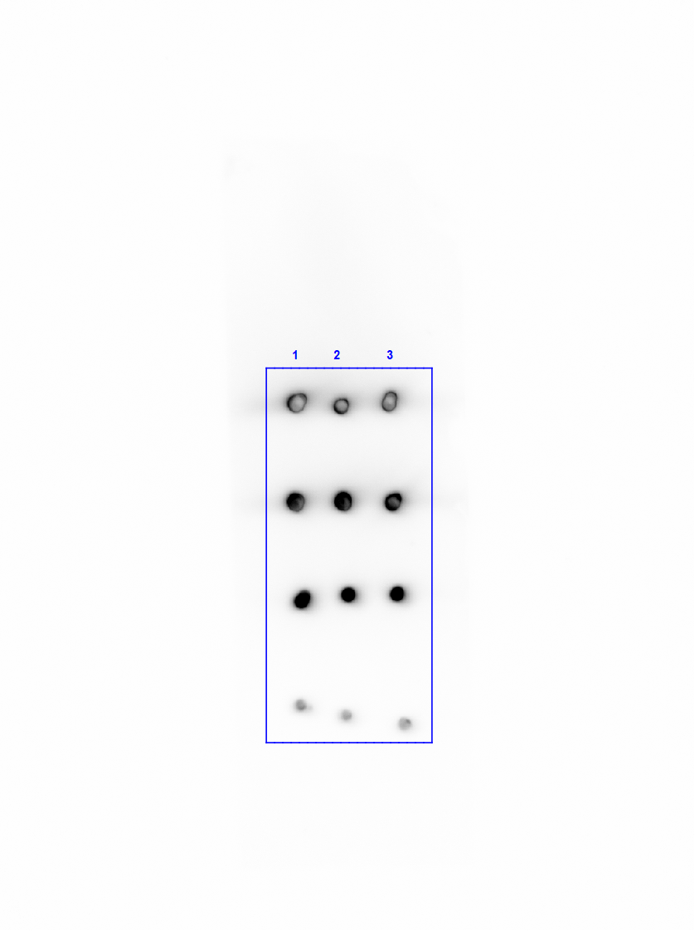
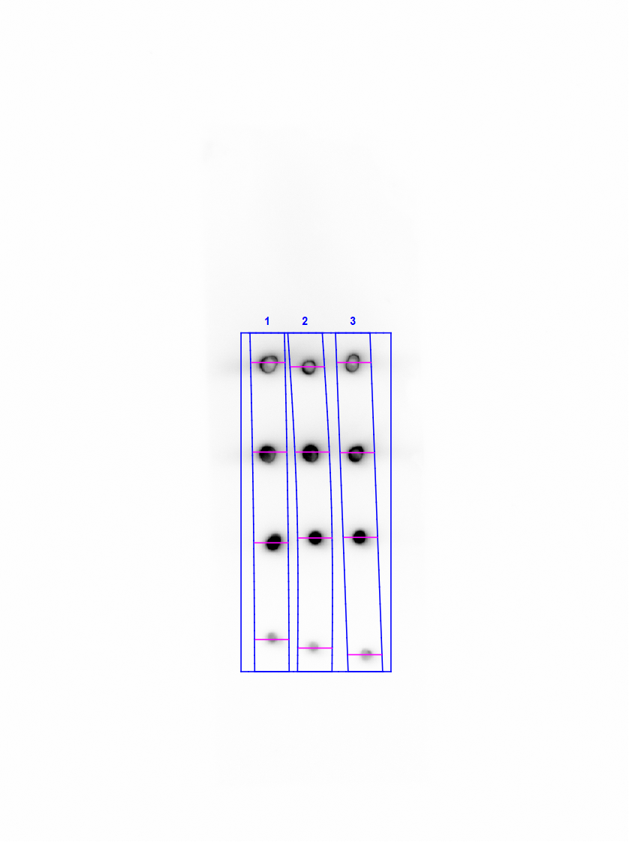
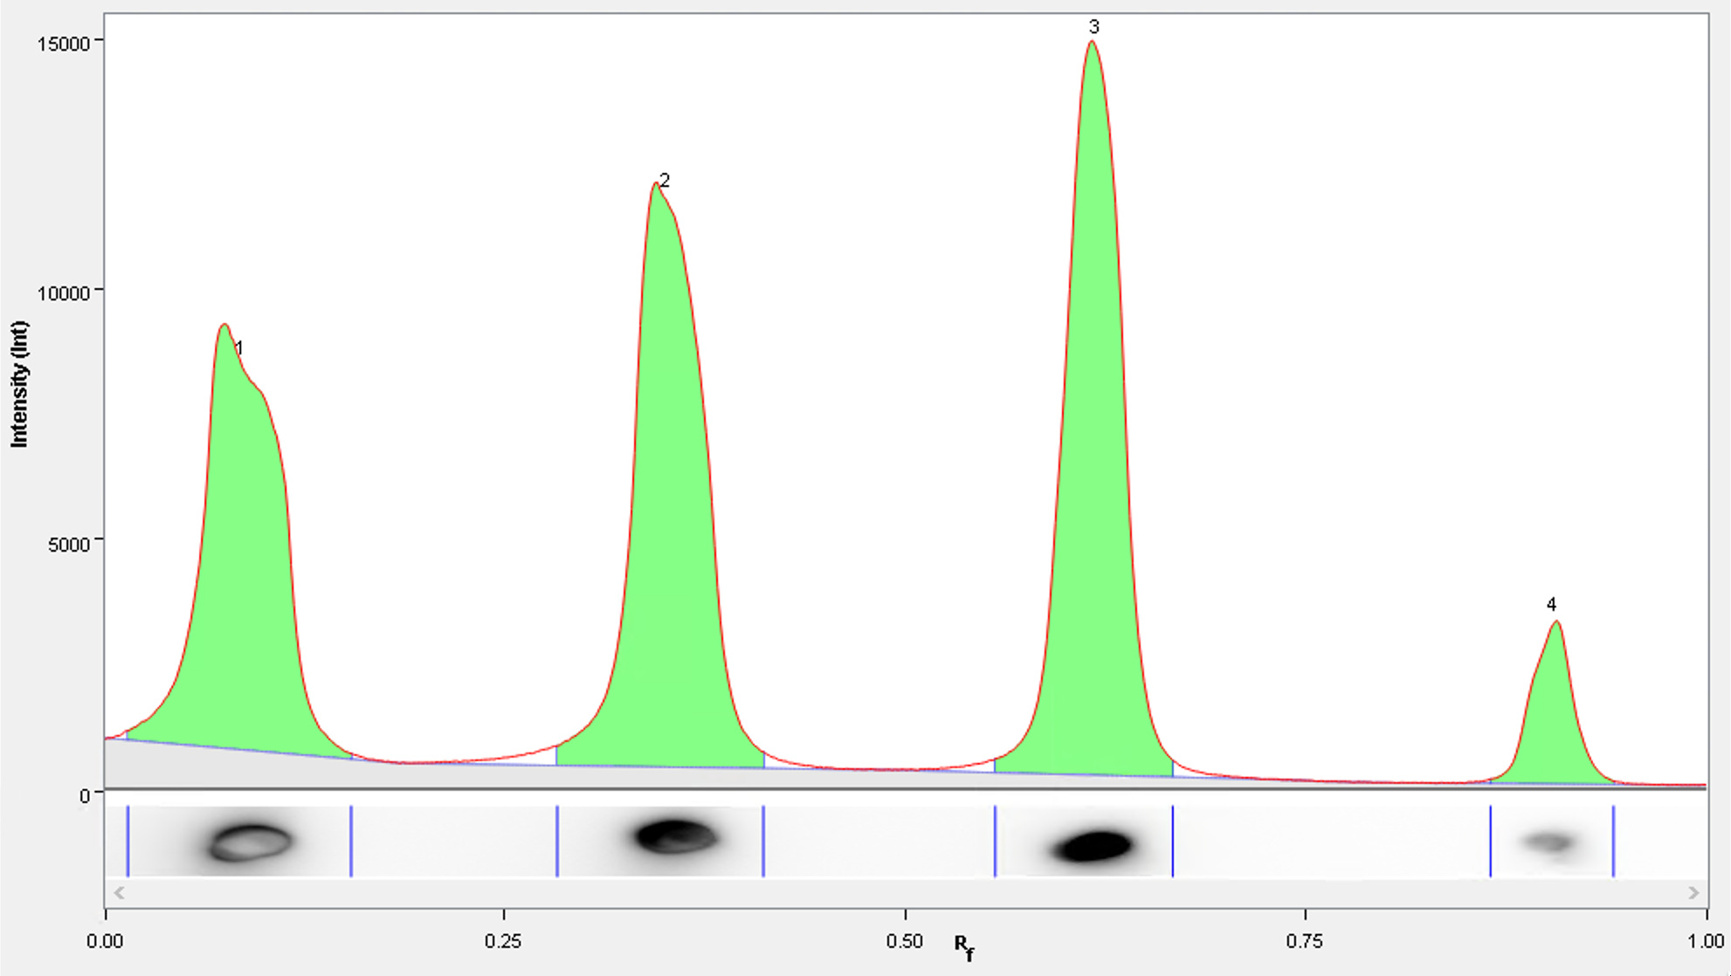
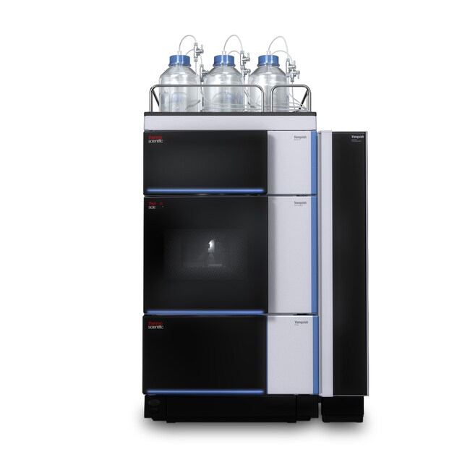
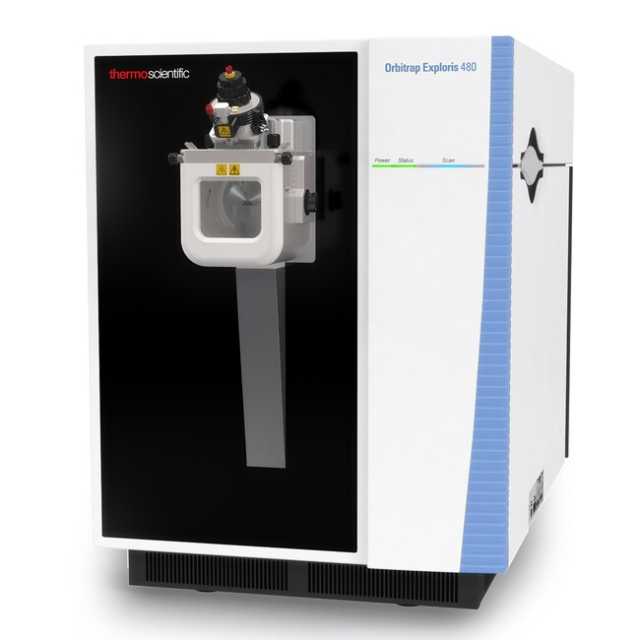

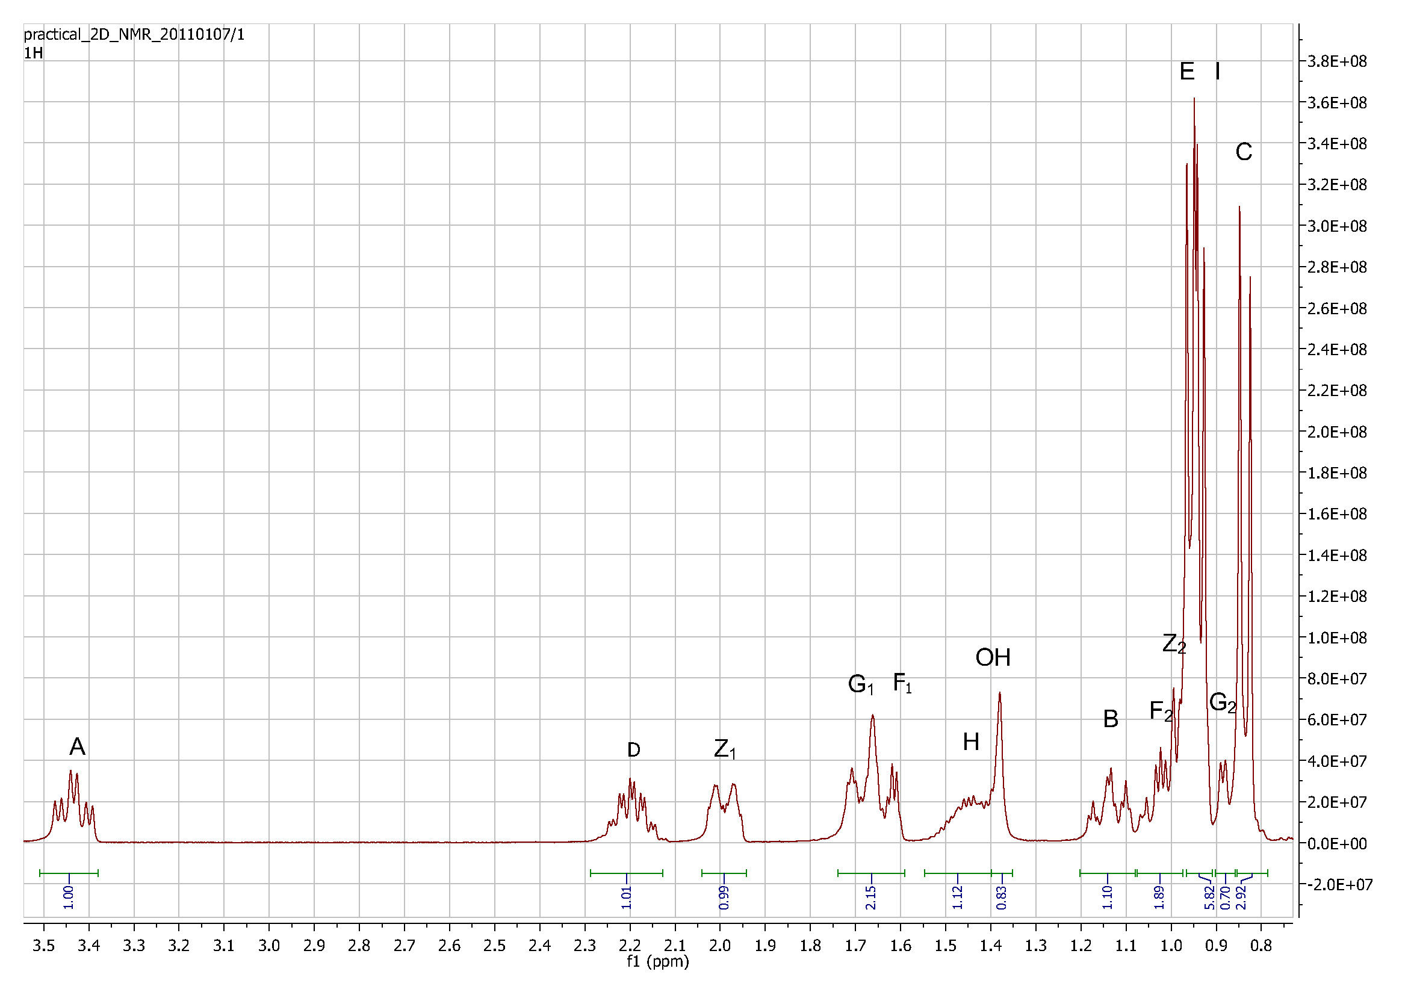
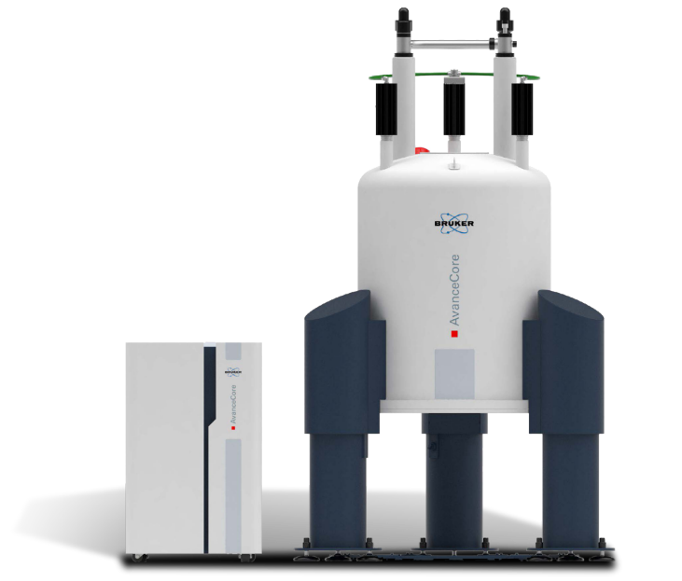
Was sind diese Plots, welche Technik/Instrument stammen sie und wo ist der Peak?
Dünnschichtchromatographie:
Thin-Layer Chramotography (TLC)
m/z 824.54
NL: 8.12E5
15.26
100
90
80
70
60
Zhixu Ni, unpublished experiment results, 2014
Relative Abundance
50
40
Flüssigchromatographie mit Massenspektrometrie-Kopplung:
Liquid chromatography–
mass spectrometry (LC-MS)
Kernspinresonanzspektroskopie:
Nuclear magnetic resonance (NMR)
30
14.77
20
10
14.30
0
13
14
15
16
17
18
Time (min)
Zhixu Ni, ¹H NMR spectrum of Menthol, Master practical NMR course
Supervised by Prof. Stefan Berger, Uni Leipzig, 2011
Zhixu Ni, Georgia Angelidou, Mike Lange, Ralf Hoffmann, Maria Fedorova. (2017) Analytical Chemistry, 2017, 89 (17), pp 8800–8807.
Notes:
"Wie viele von Ihnen wissen, was Bild 2 ist? Heben Sie bitte die Hand.

Slide 3
LC-MS Peak und Peak-Picking
NL: 8.12E5
m/z 824.54
15.26
100
90
Was ist ein Peak in LC-MS Rohdaten?
What is a peak in LC-MS raw data?
Warum brauchen wir Peak-Picking in die LC-MS?
Why we need peak picking in LC-MS?
Wie macht man Peak-Picking in die LC-MS?
How to make peak picking in LC-MS?
80
70
60
Relative Abundance
50
40
30
14.77
20
10
14.30
0
13
14
15
16
17
18
Time (min)
Zhixu Ni, Georgia Angelidou, Mike Lange, Ralf Hoffmann, Maria Fedorova. (2017) Analytical Chemistry, 2017, 89 (17), pp 8800–8807.

Slide 4
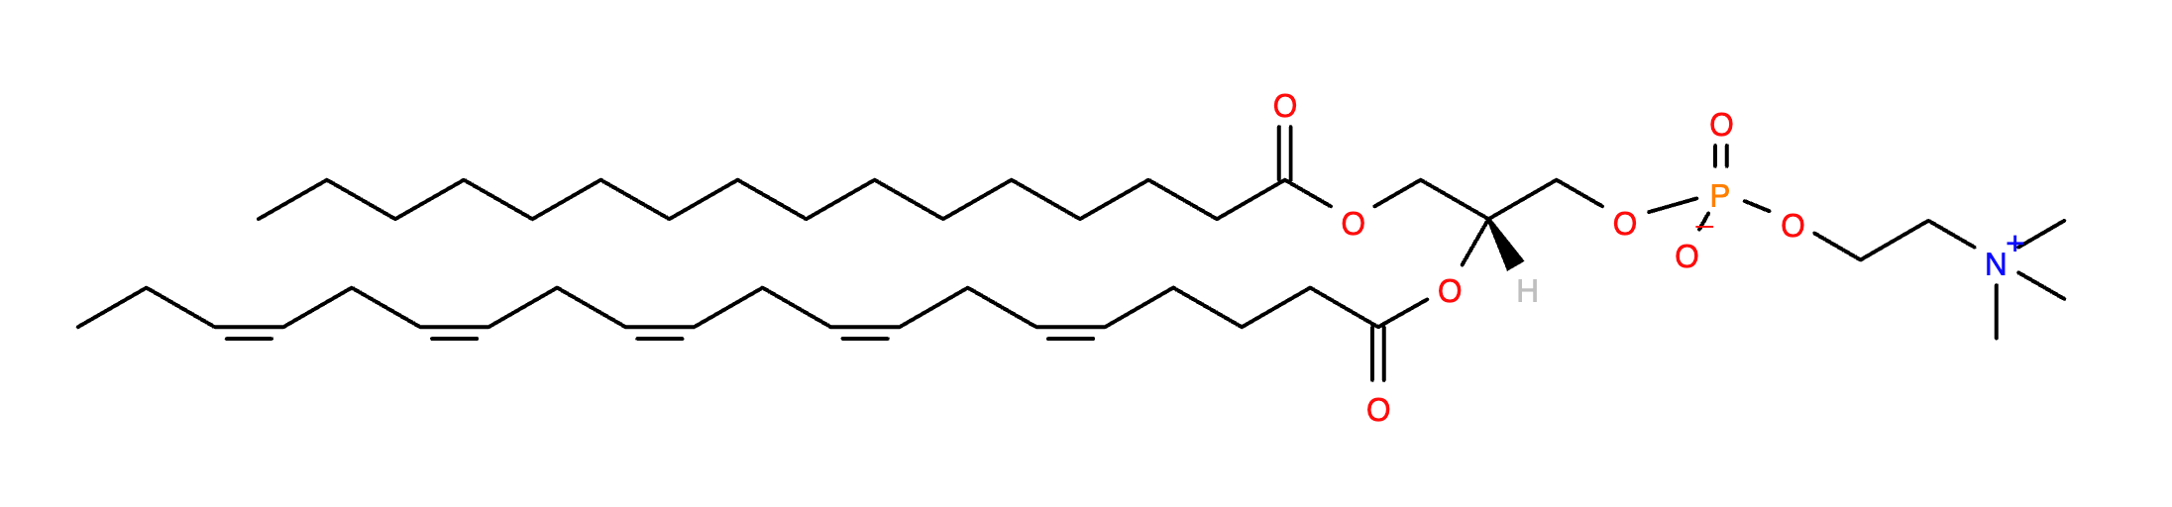
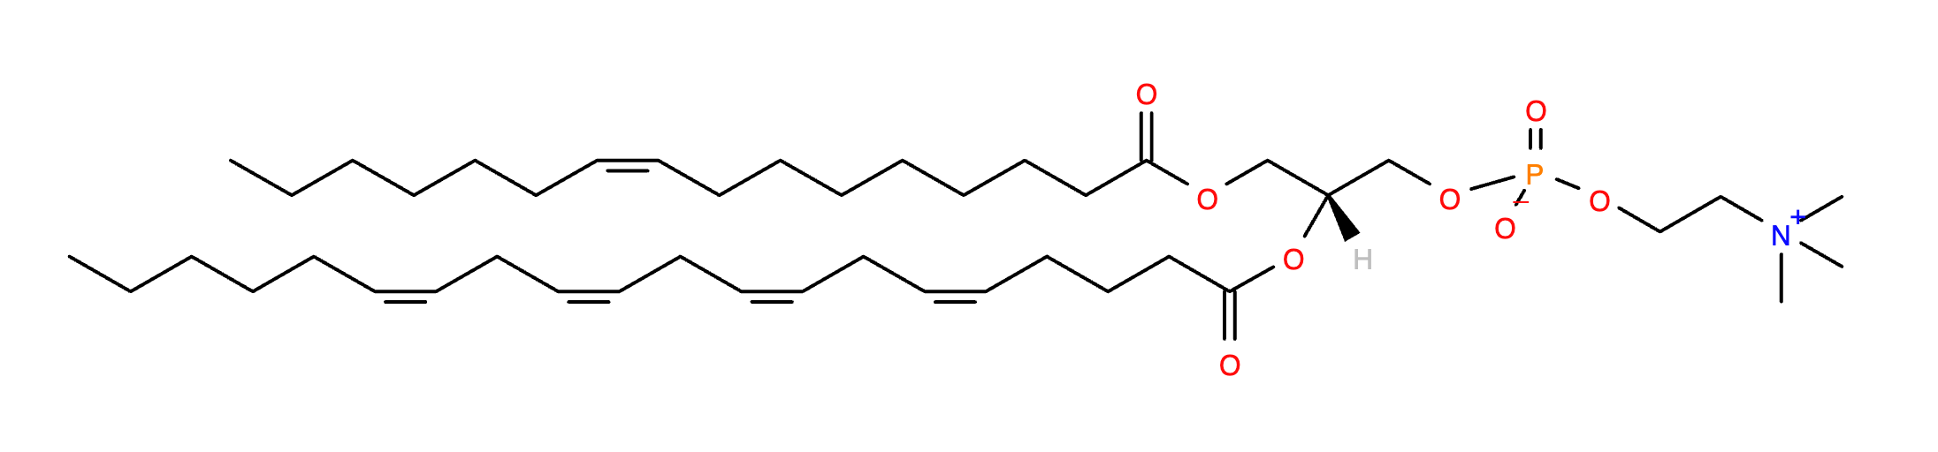
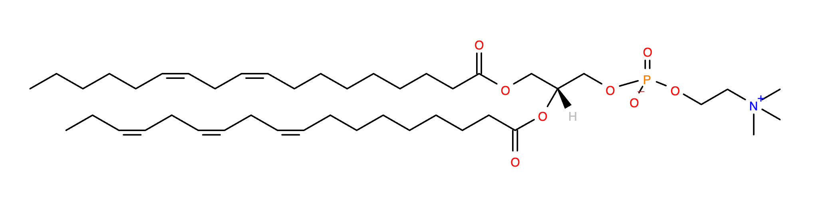
LC-MS peaks for isomer detection
# Daher wechsle ich jetzt ins Englische.
C
NL: 8.12E5
15.26
C
100
XIC m/z 824.54
C₄₅H₇₉NO₁₀P⁻
90
Different peak in LC
Different compound
No structure information
80
B
70
LC
60
Relative Abundance
LC-MS peaks → Quantify compounds
50
40
MS
A
B
30
14.77
Different peak sets in MS2
Different compound
No quantity information
20
A
10
14.30
0
13
14
15
16
17
18
Time (min)
Zhixu Ni, Georgia Angelidou, Mike Lange, Ralf Hoffmann, Maria Fedorova. (2017) Analytical Chemistry, 2017, 89 (17), pp 8800–8807.
Notes:
Dieses Thema ist zu schwierig für mich, um es Ihnen auf Deutsch zu erklären. Um sicherzustellen, dass meine Erklärung korrekt ist, werde ich jetzt ins Englische wechseln.

Slide 5
What is a peak in LC-MS raw data?
XIC: EXtracted
TIC: Total
XIC @ m/z
Ion
Current
Chromatogram
EIC
Ion
Current
Chromatogram
RT
RT
4
m/z
4
3
3
Trace the intensity of m/z over time
5
5
m/z
2
6
m/z
1
7
RT
2
6
m/z
m/z
XIC @ m/z
MS1 spectrum
m/z | Time (min) | Intensity (Abs)
… | … | …
824.5449 | 17.02 | 11000
824.5446 | 17.04 | 19000
824.5447 | 17.06 | 27500
824.5445 | 17.08 | 17300
… | … | …
1
7
m/z
m/z
RT
Retention time (RT)

Slide 6
LC-MS XIC peak shape related to number of raw data points
Apex?
Hochpunkt?
XIC @ m/z
XIC @ m/z
Low number of points on peak
→ Missing peak apex
Same m/z + More points on peak
→ Better peak shape
Ni, Zhixu, et al. "LipidHunter identifies phospholipids by high-throughput processing of LC-MS and shotgun lipidomics datasets."
Analytical Chemistry 89.17 (2017): 8800-8807.

Slide 7
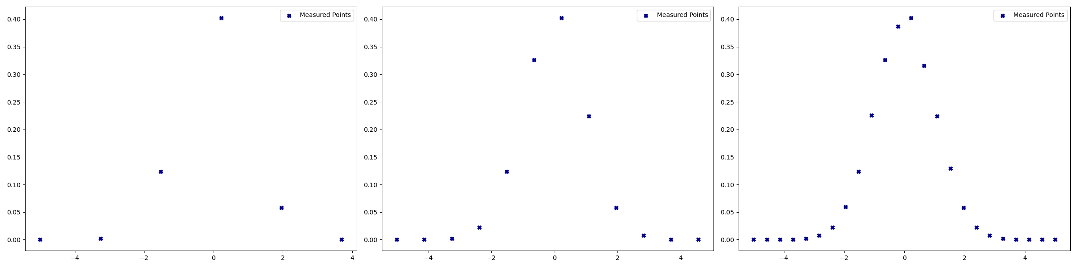
Measurement settings changes number of points in the raw data
6 points in window
12 points in window
24 points in window

Slide 8
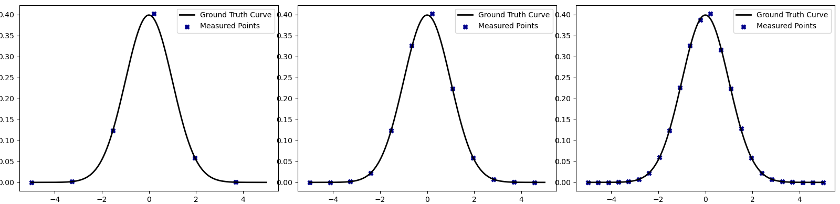
Number of points on peak v.s. total number of points
4 points on peak
8 points on peak
15 points on peak
6 points in window
12 points in window
24 points in window
More frequent MS1 scan → More data points on LC-MS XIC → Better peak shape

Slide 9
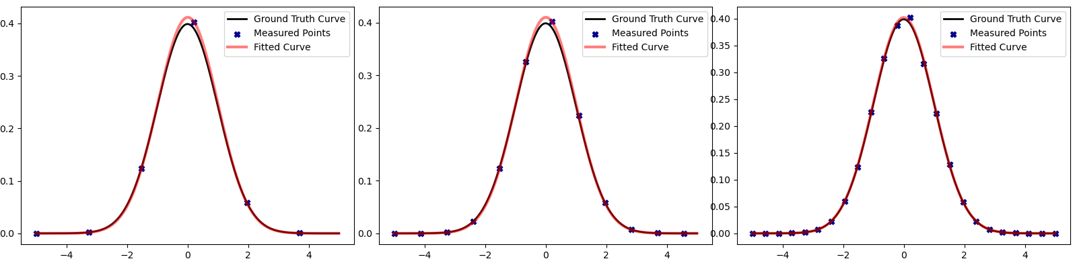
Fit Curve from experimental data points
4 points on peak
8 points on peak
15 points on peak
+1.68% peak area
+1.26% peak area
+ 0.70% peak area
More points on peak → Closer to the true peak area → Better quantification results

Slide 10
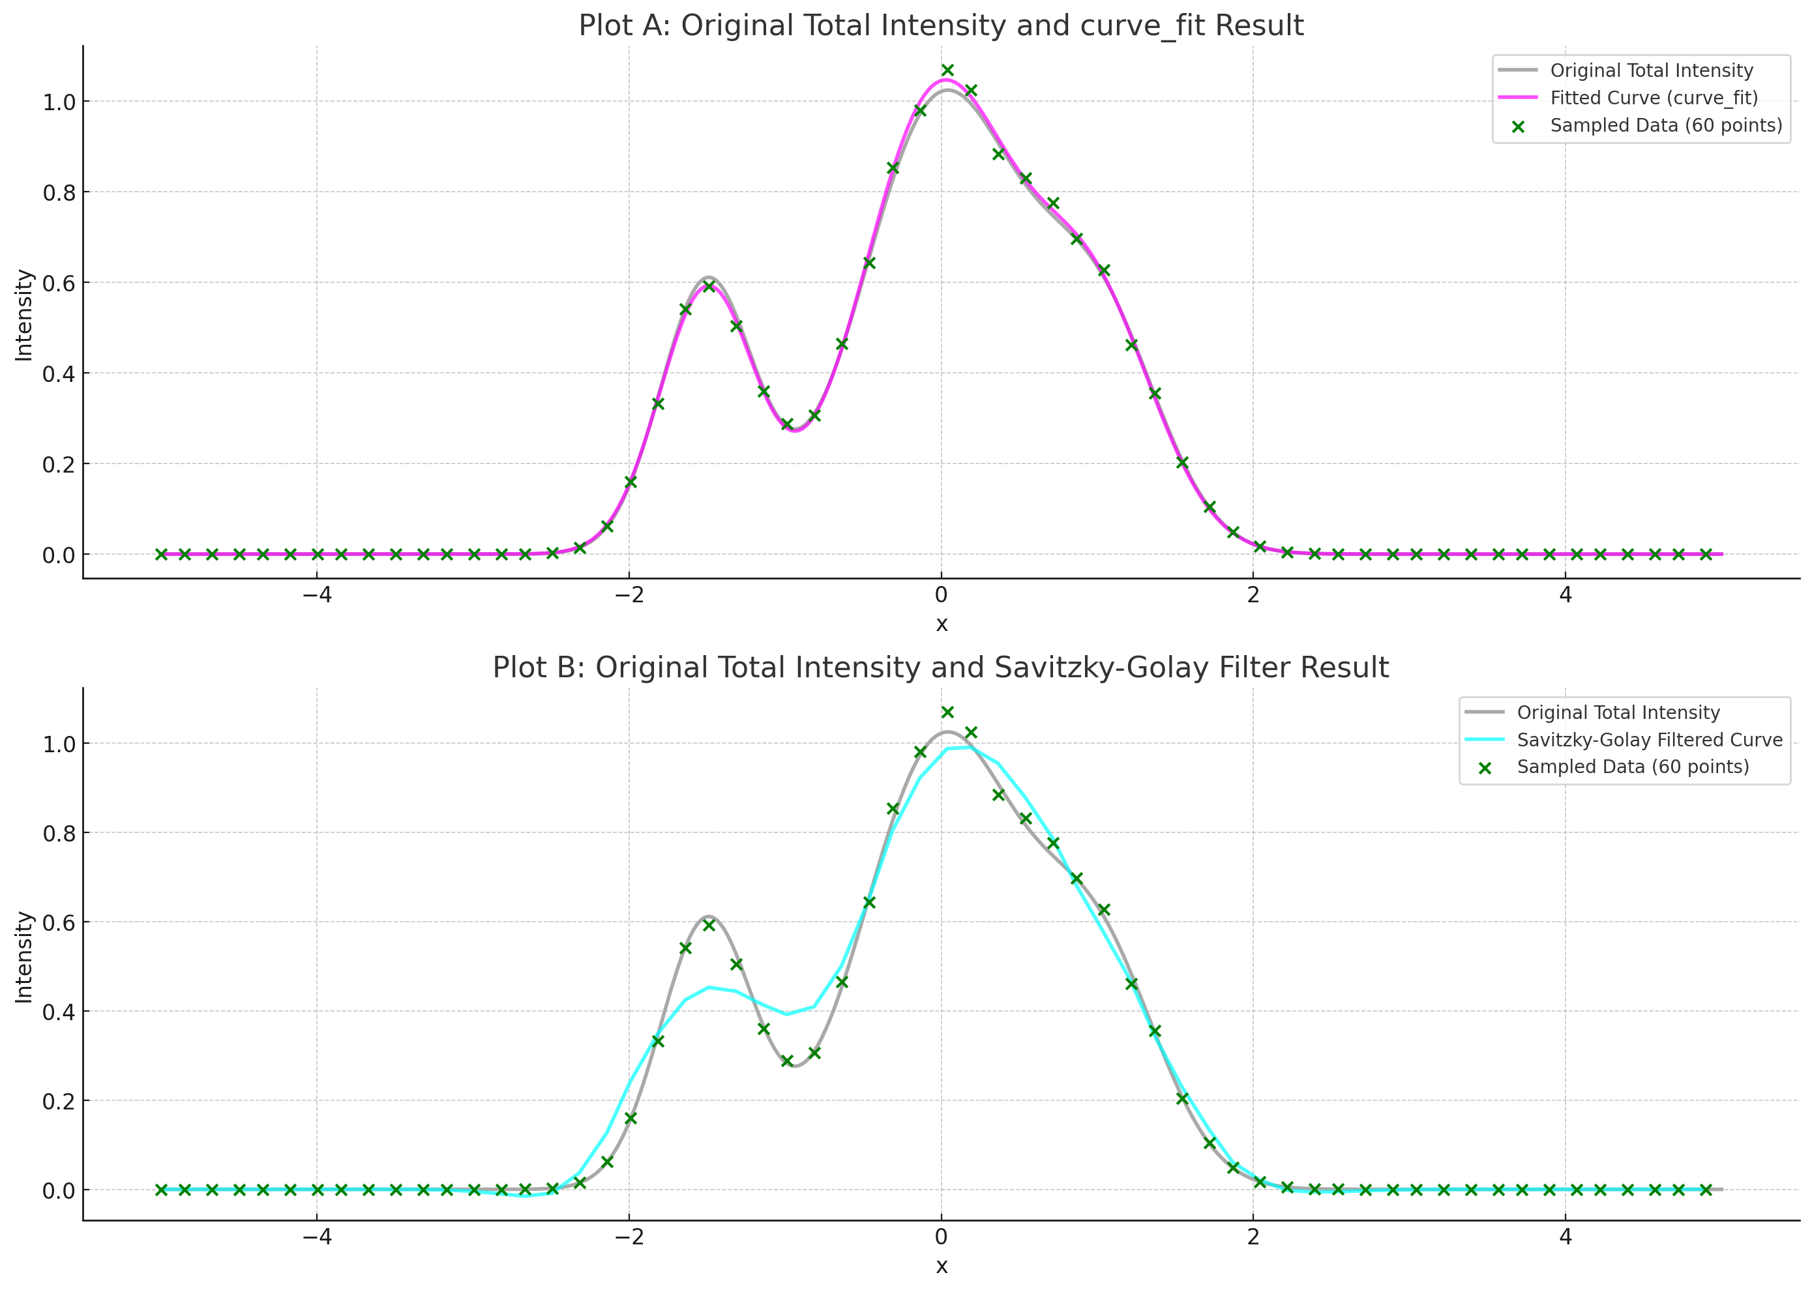
More complex situations for curve fitting and smoothing
! Peak area changes !

Slide 11
Short summary for LC-MS background
What is a peak in LC-MS raw data?
Why we need peak picking in LC-MS?
How to make peak picking in LC-MS?
C
LC-MS Extracted Ion Chromatogram (XIC)
LC-MS XIC peaks → Quantify compounds
B
A
X
Ni, Zhixu, et al. "LipidHunter identifies phospholipids by high-throughput processing of LC-MS and shotgun lipidomics datasets."
Analytical Chemistry 89.17 (2017): 8800-8807.

Slide 12
Short summary for LC-MS background
Local Maximum Method
Window Search Method
Peak prominences
Gaussian Derivative based Method
Continuous wavelet transform (CWT)
… …
C
B
A
X
https://www.originlab.com/doc/X-Function/ref/pkFind
https://www.mathworks.com/help/signal/ref/findpeaks.html
https://docs.scipy.org/doc/scipy/reference/generated/scipy.signal.find_peaks.html
https://sneumann.github.io/xcms/reference/findPeaks.centWave-methods.html
https://pubs.acs.org/doi/10.1021/ac051437y
Let’s do some math!
Zhou, B., Xiao, J. F., Tuli, L., & Ressom, H. W. (2012). LC-MS-based metabolomics. Molecular BioSystems, 8(2), 470-481.

Slide 13
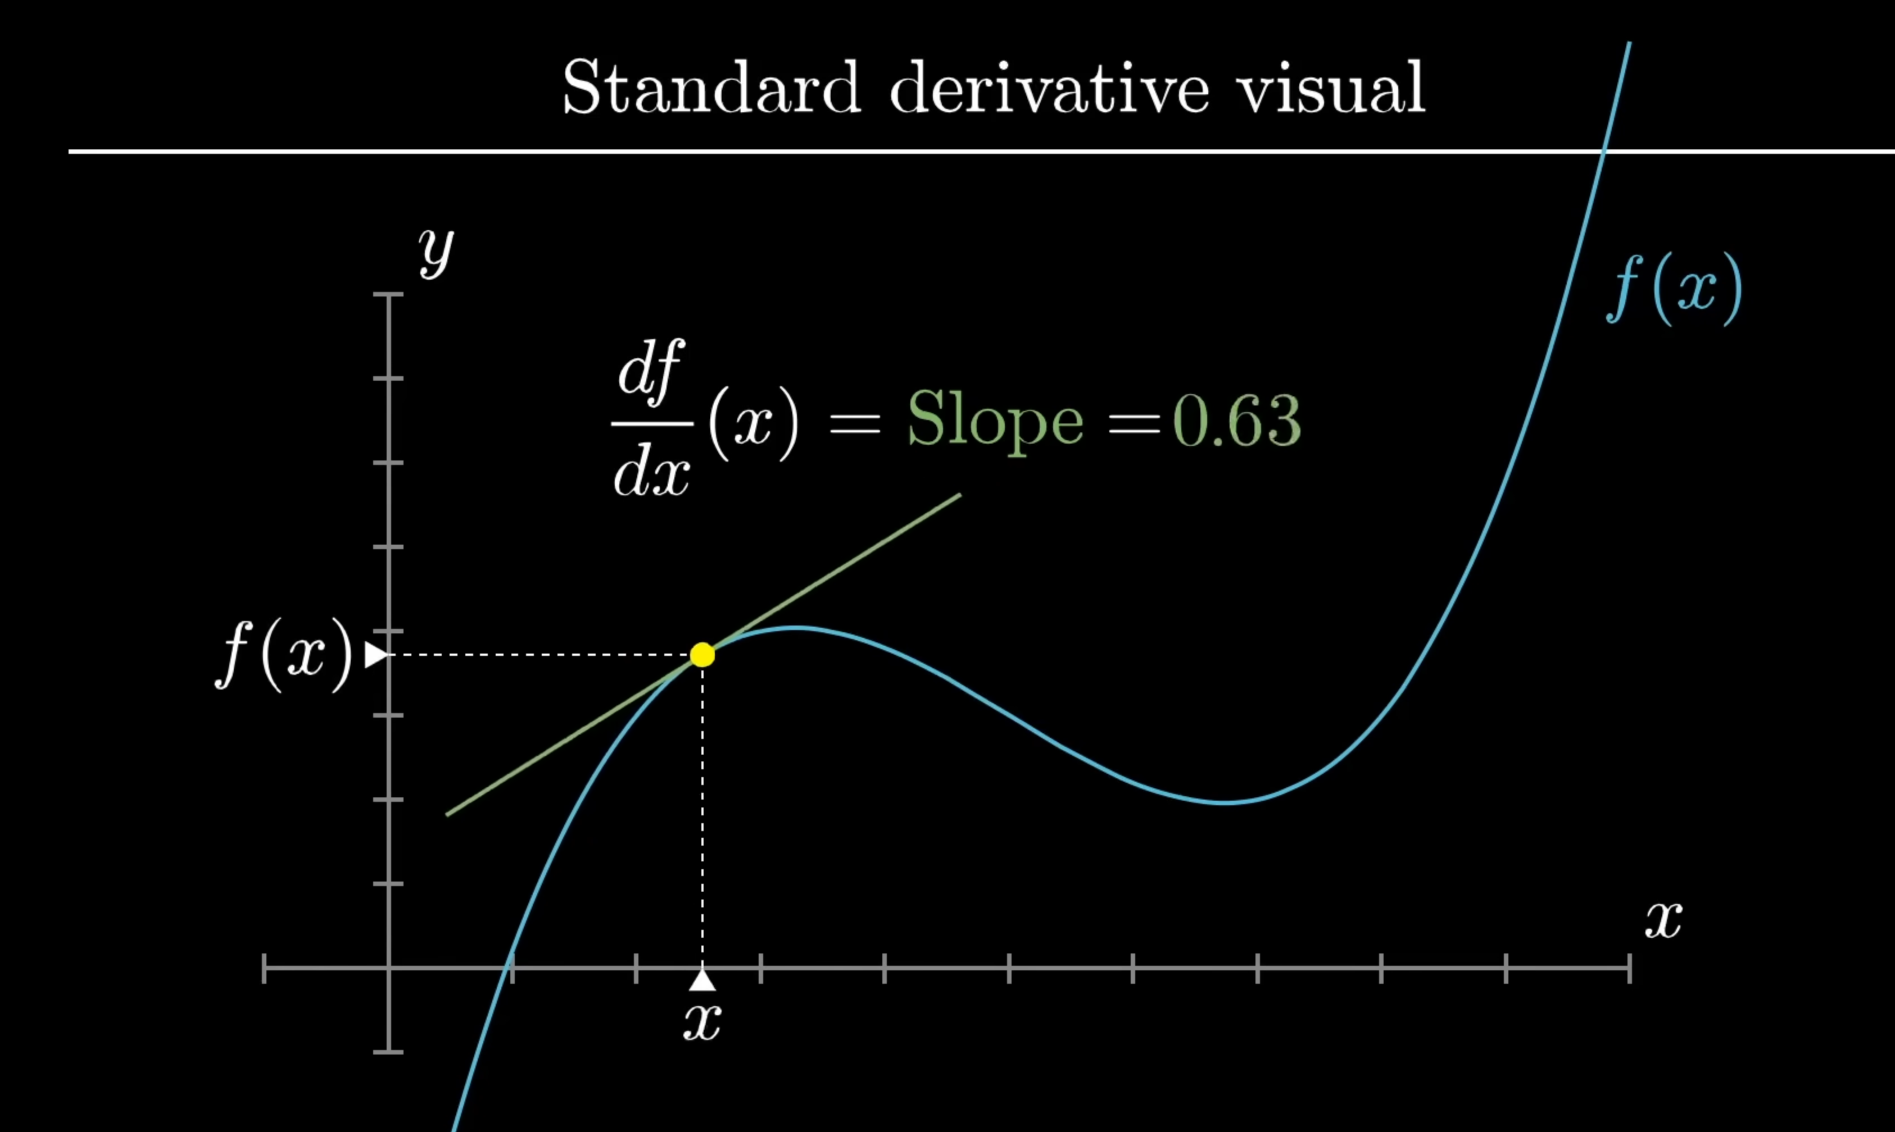
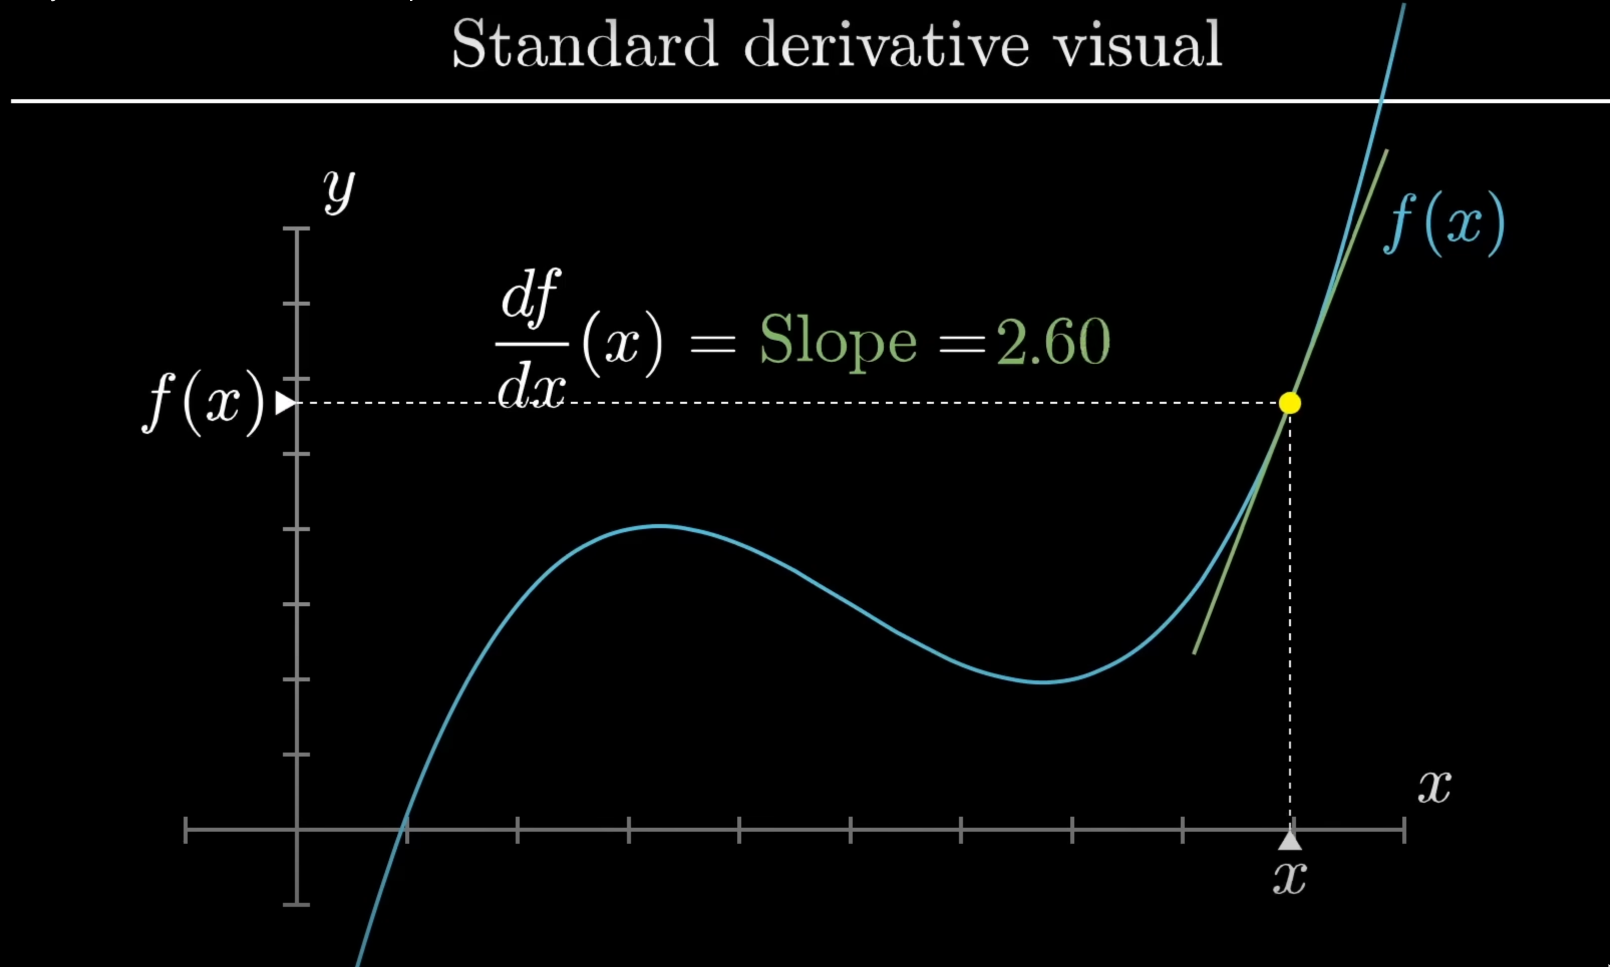
Derivative: Die Erste Ableitung
https://www.3blue1brown.com/lessons/derivatives-and-transforms

Slide 14
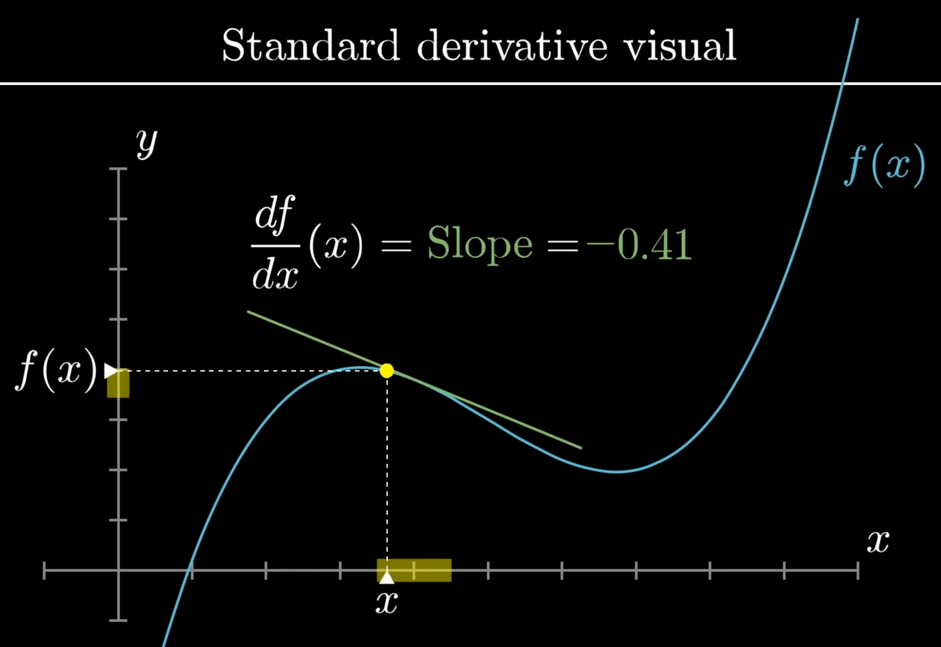
Derivative: Die Erste Ableitung
https://www.3blue1brown.com/lessons/derivatives-and-transforms

Slide 15
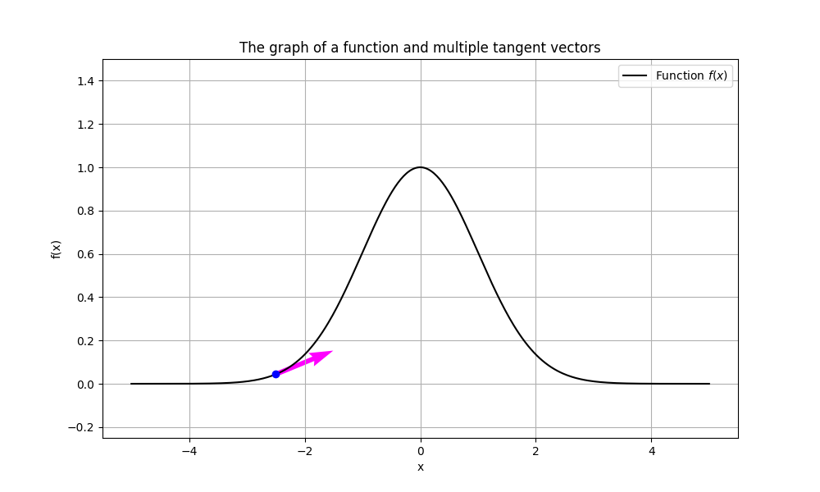
Simplified gaussian first derivative for a symmetric peak
Derivative: Die Erste Ableitung

Slide 16
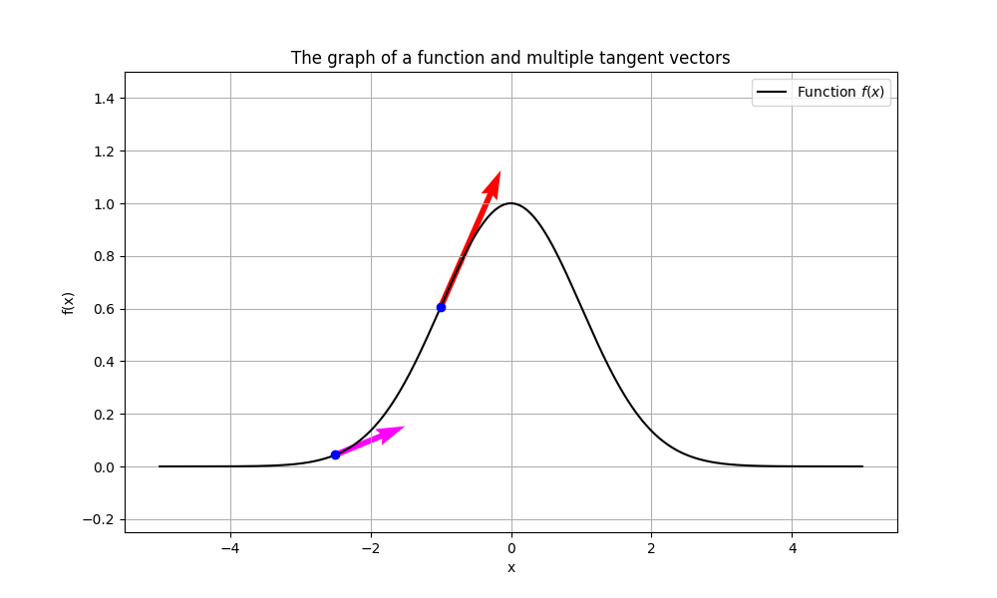
Simplified gaussian first derivative for a symmetric peak

Slide 17
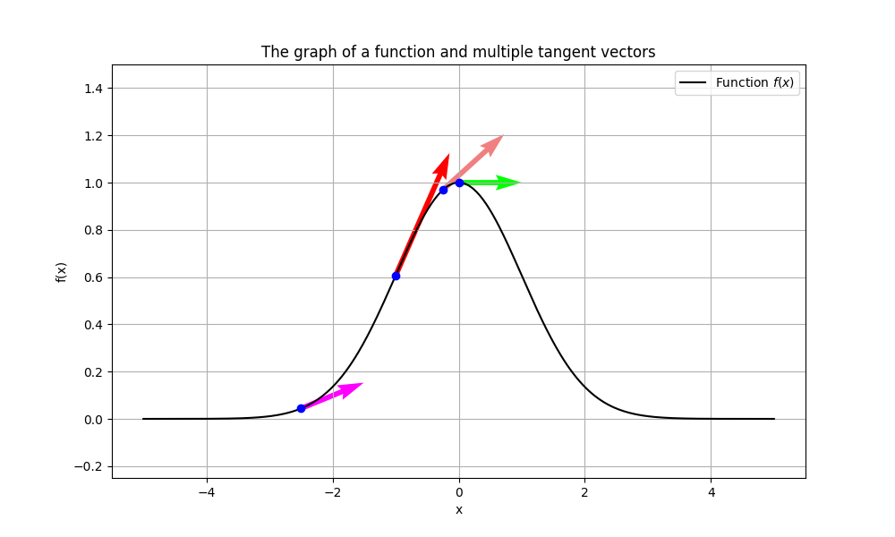
Simplified gaussian first derivative for a symmetric peak

Slide 18
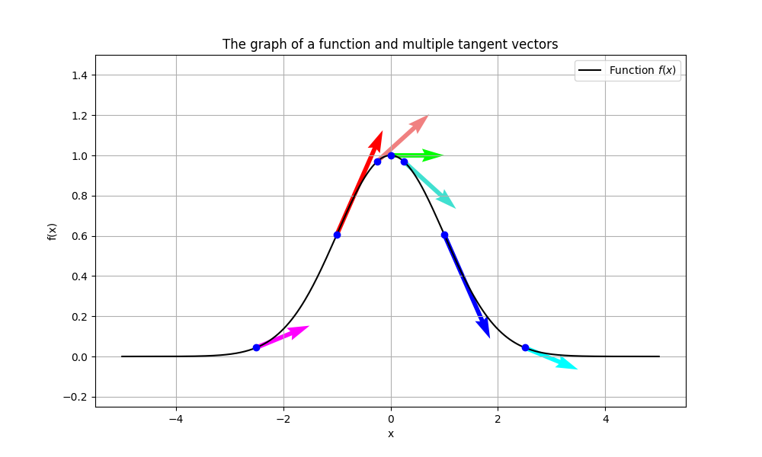
Simplified gaussian first derivative for a symmetric peak
0
Above 0
Below 0

Slide 19
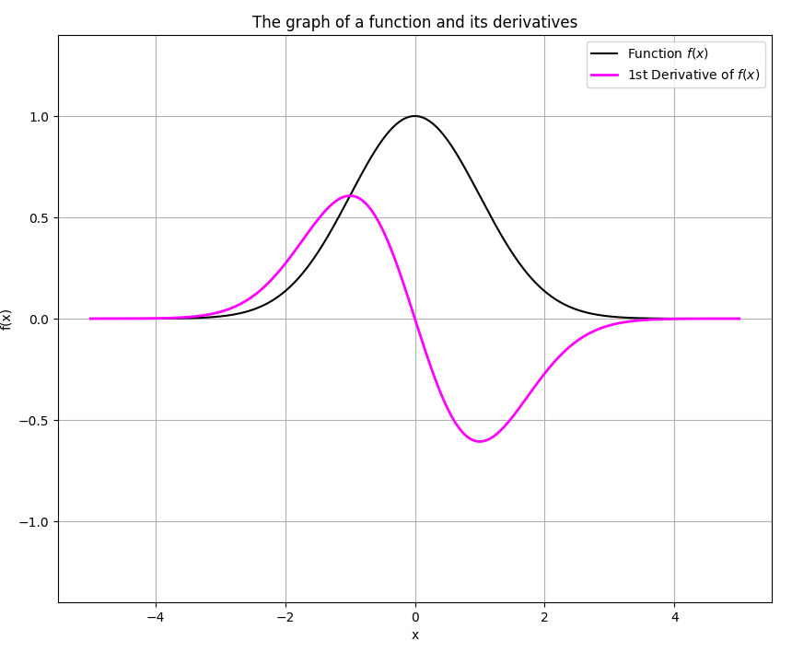
Simplified gaussian first derivative for a symmetric peak
0
Above 0
Increase from zero
Below 0
Increase to zero
Zero Crossing

Slide 20
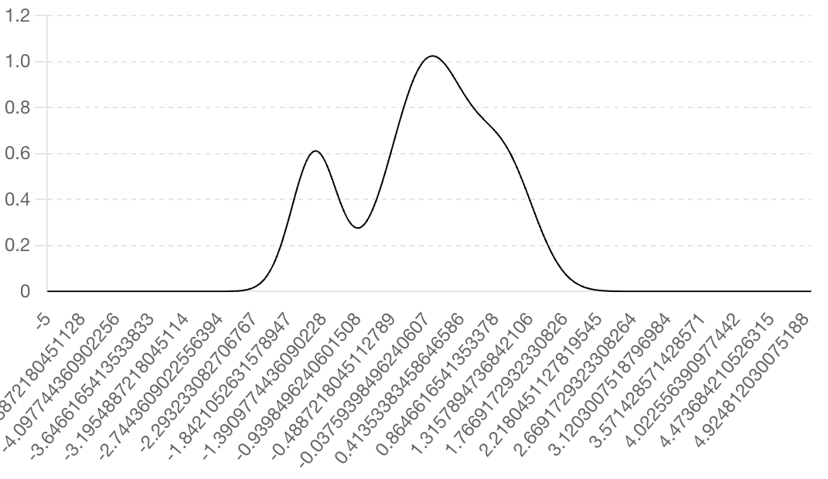
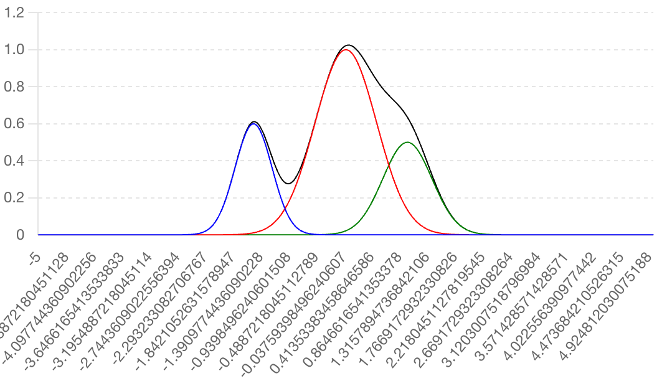

More complex situations
How many peak(s) can you find here?
A proposed solution with a hidden peak
1
2
3

Slide 22
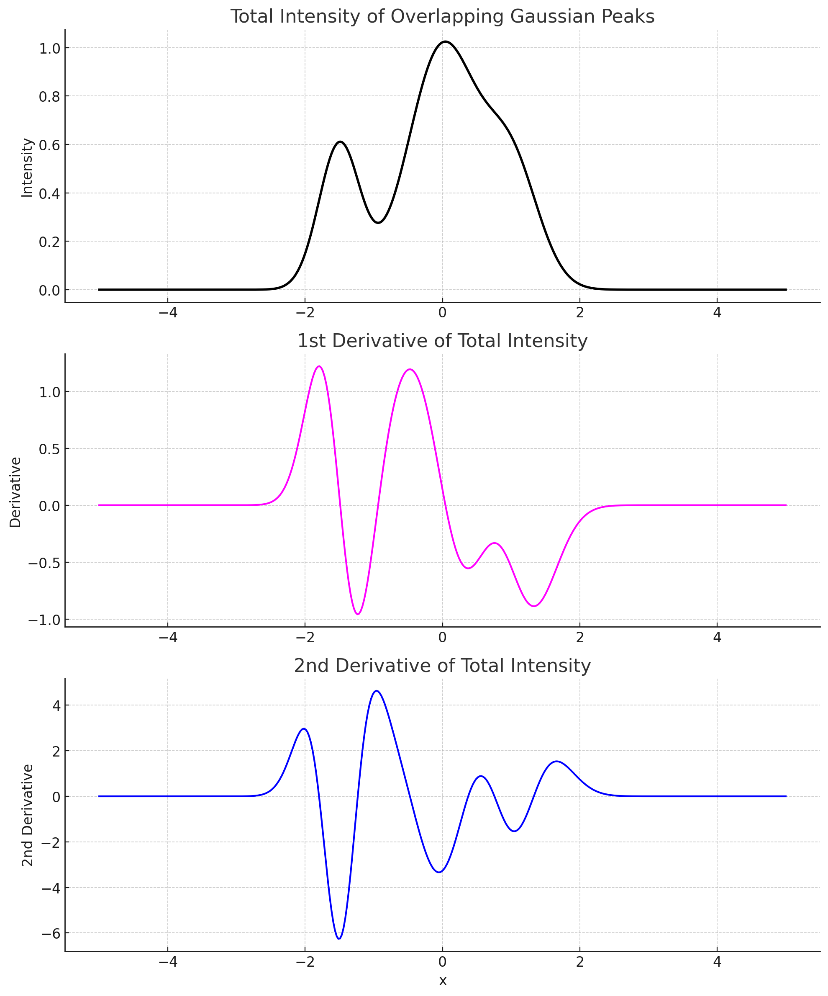


First derivative curve

Slide 23
First derivative curve
Die Erste Ableitung
Tiefpunkt
Tief Punkt
Take derivative of the 1st derivative
2nd derivative
Die Zweite Ableitung

Slide 24
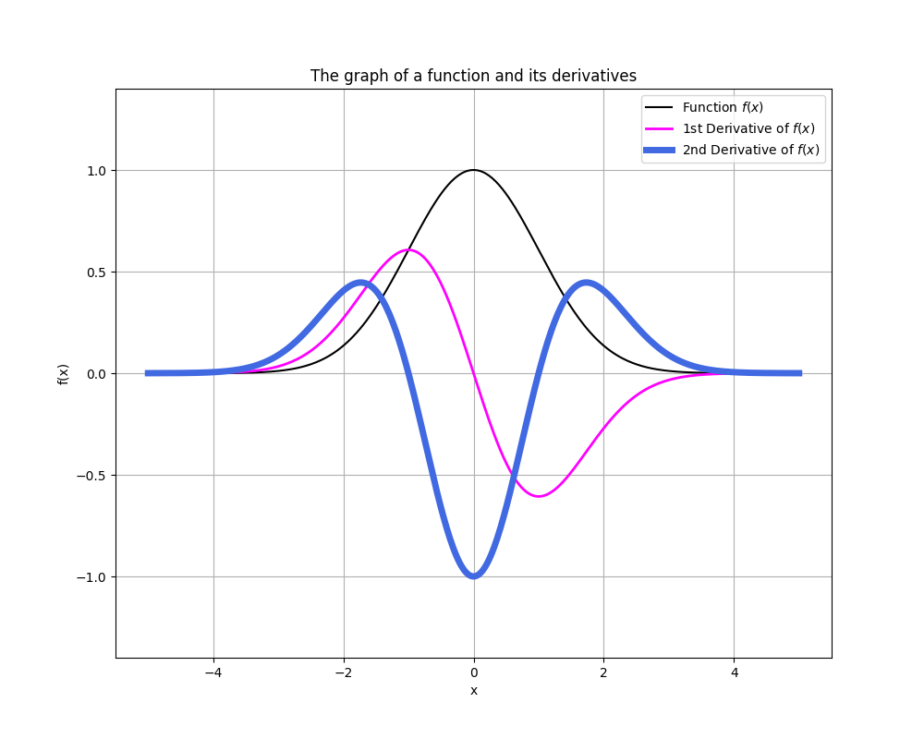
First derivative curve
Tiefpunkt
Second derivative curve
Second derivative curve
Second derivative: die Zweite Ableitung

Slide 25
Second derivative curve
Second derivative: die Zweite Ableitung

Slide 26
Short summary
The LC-MS XIC: the Intensity changes over Time for defined mass/charge ratio (m/z)
Different peaks in LC-MS XIC → different molecules (with same formula)
Peak picking has many different algorithms
Gaussian Derivative, Continuous wavelet transform (CWT) , and more
Gaussian Derivative based algorithms
1st derivative + zero crossing
2nd derivative
B
A
1st
2nd
2nd

Slide 27
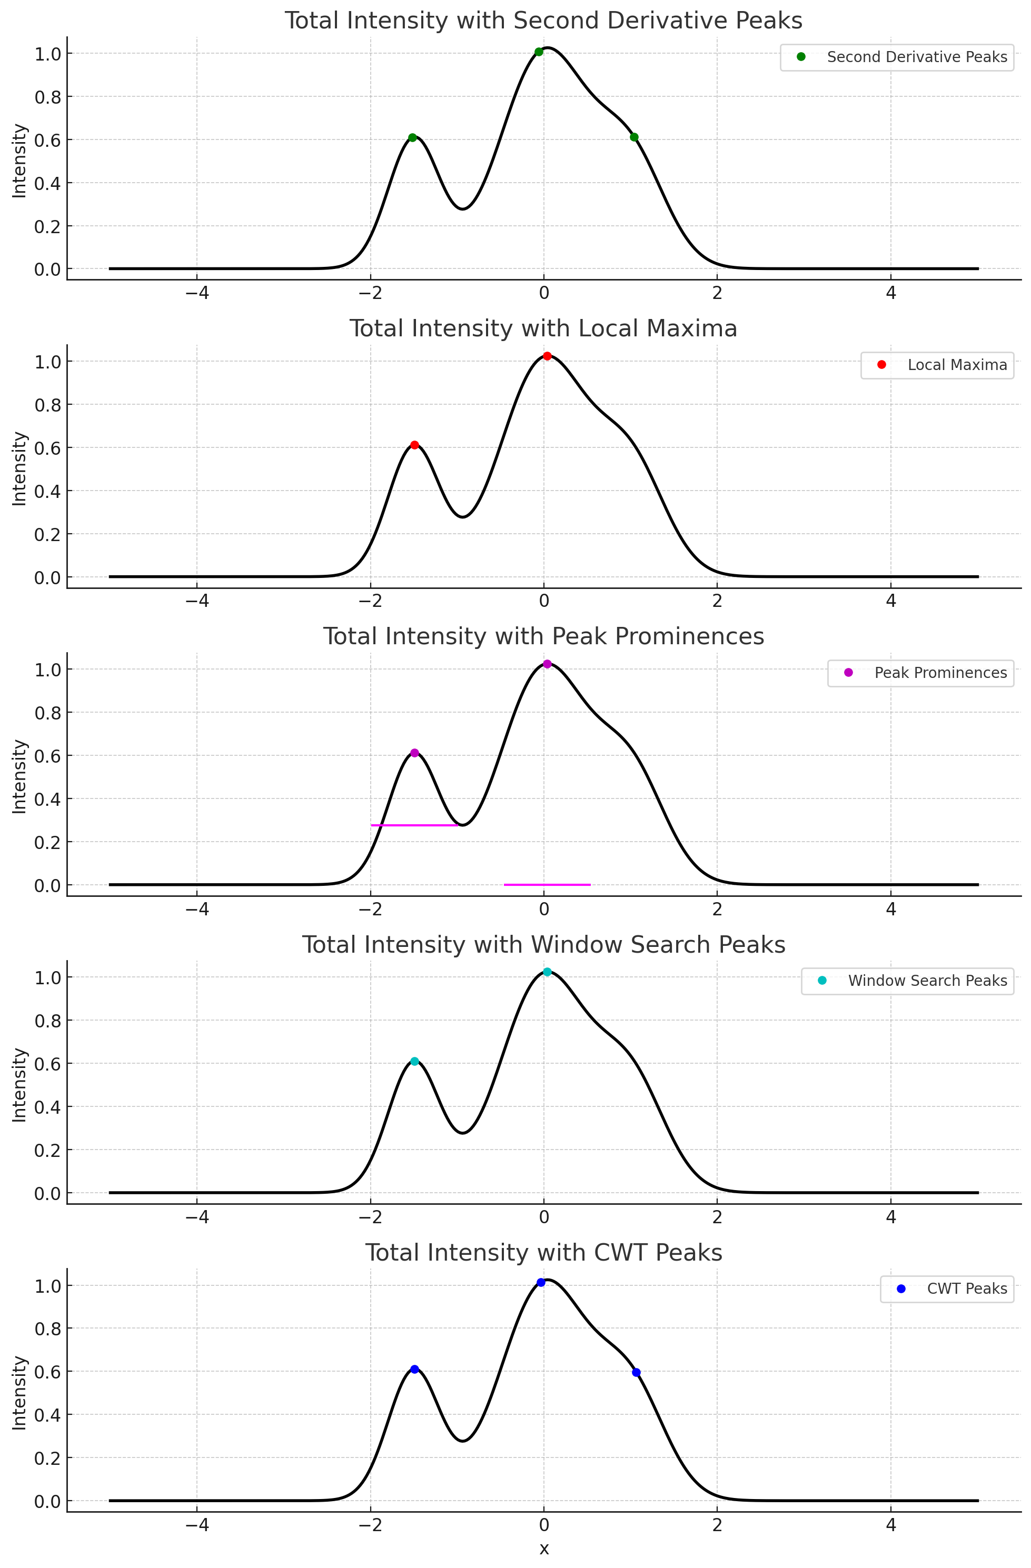
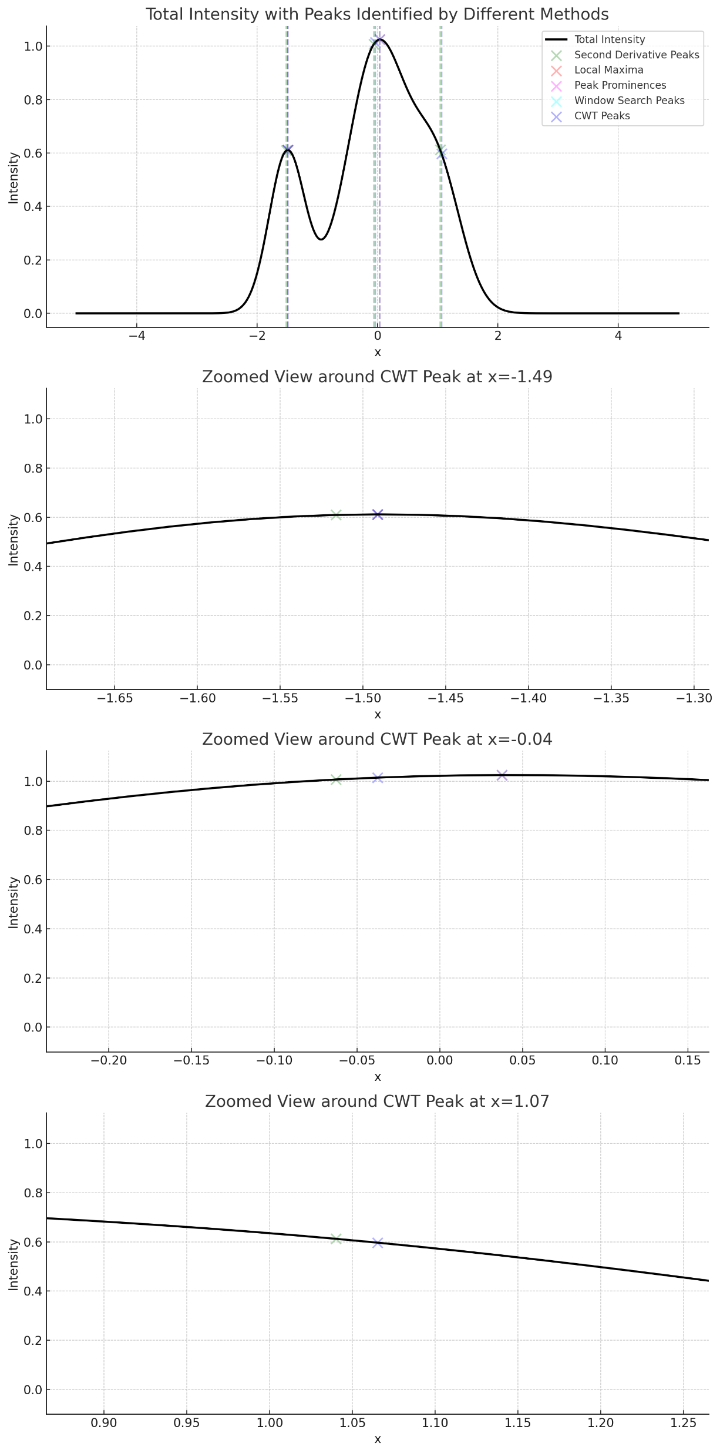
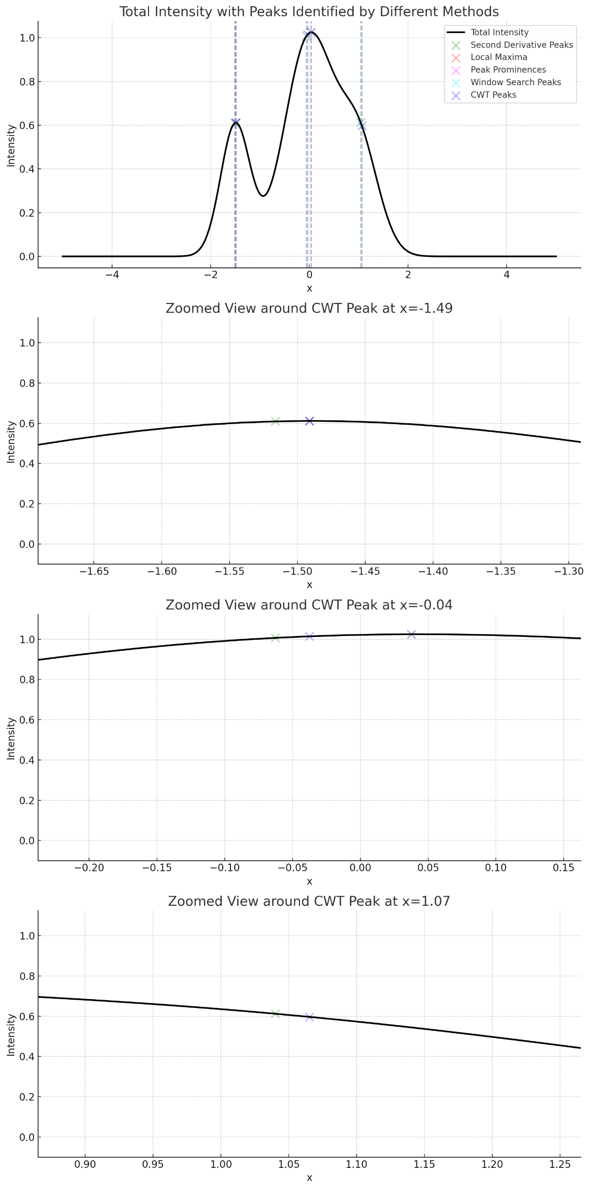
A short comparision of different algorithms
Different number of peaks
Different position of Peak Apex
Gaussian 2nd derivative
Gaussian
2nd derivative
Overlay of 5 algorithms
Continuous
wavelet
transform
(CWT)
Continuous wavelet transform (CWT)

Slide 28

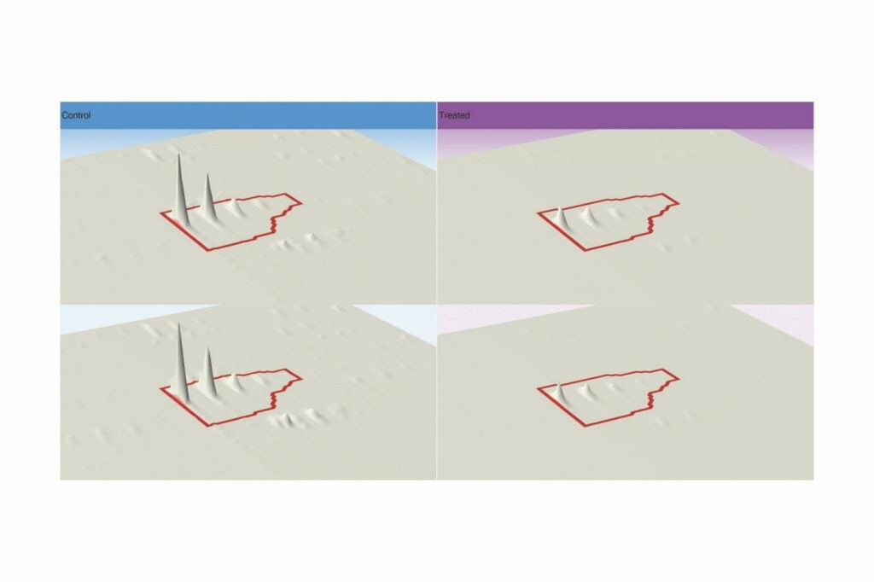
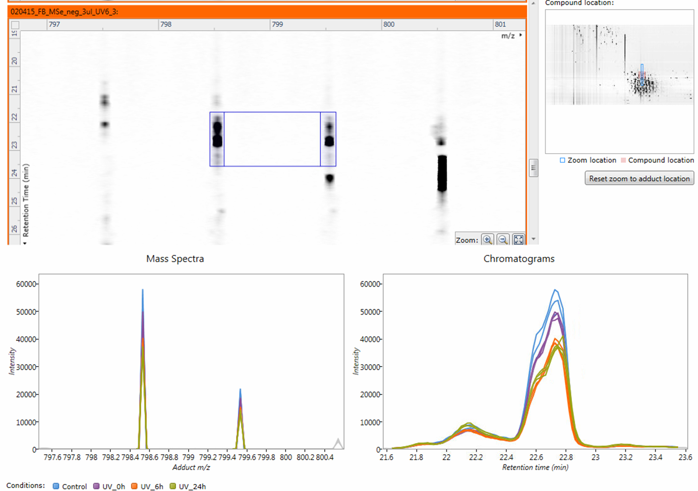
Think from chromatography side
Dünnschichtchromatographie:
Thin-Layer Chramotography (TLC)
802 m/z
intensity
m/z
time
LC-MS in 3D plot
LC-MS in 2D plot
intensity
m/z
m/z
time
Intensity → gray scale → peak in Rf
time
Intensity → gray scale → peak by time
Zhixu Ni, unpublished experiment results, 2014
https://www.waters.com/nextgen/de/de/products/informatics-and-software/
mass-spectrometry-software/progenesis-qi-software/progenesis-qi.html
Progenesis software, Waters, UK.
Data From Zhixu Ni unpublished data 2015

Slide 29
Find peak in 2D/3D plot of LC-MS data
Dünnschichtchromatographie:
Thin-Layer Chramotography (TLC)
m/z
time
Peaks!
Screenshot of Progenesis software, Waters, UK. Data From Zhixu Ni unpublished data 2015

Slide 30
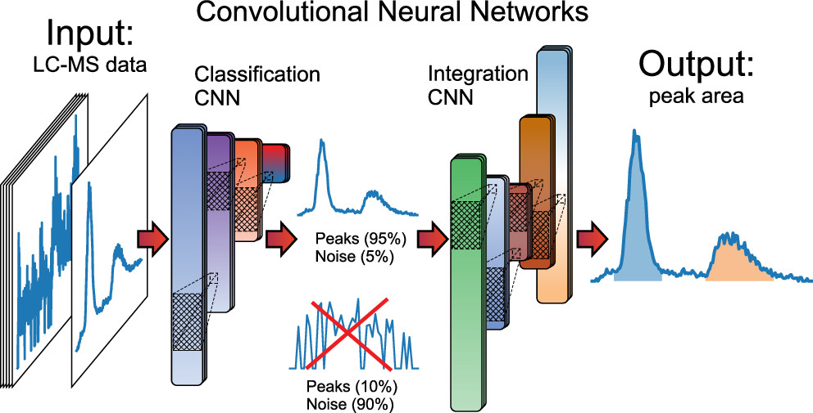
Next generation AI Assisted peak picking algorithms
Peak or no peak?
How many peaks? Peak boundaries?
Melnikov, Arsenty D., Yuri P. Tsentalovich, and Vadim V. Yanshole. "Deep learning for the precise peak detection in high-resolution LC–MS data." Analytical chemistry 92.1 (2019): 588-592

Slide 31
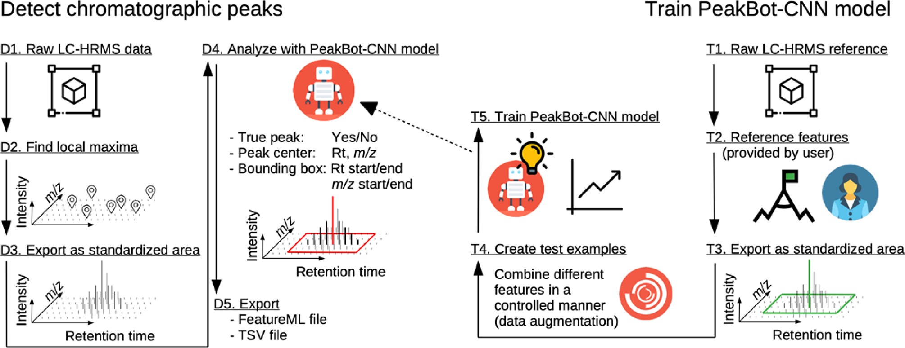
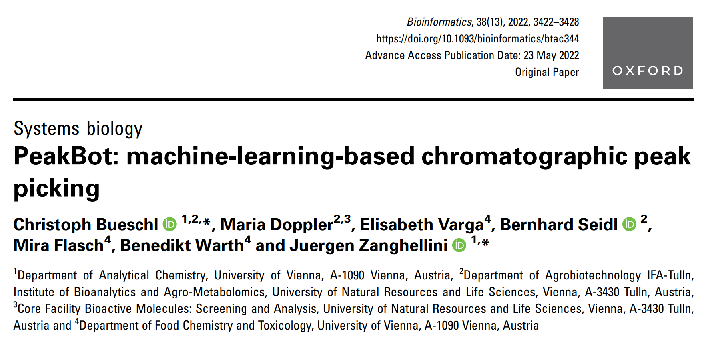
PeakBot from Uni Vienna
LC-MS in 3D plot
intensity
m/z
time
https://chemnet.univie.ac.at/ https://www.youtube.com/watch?v=E50angIHCac

Slide 32
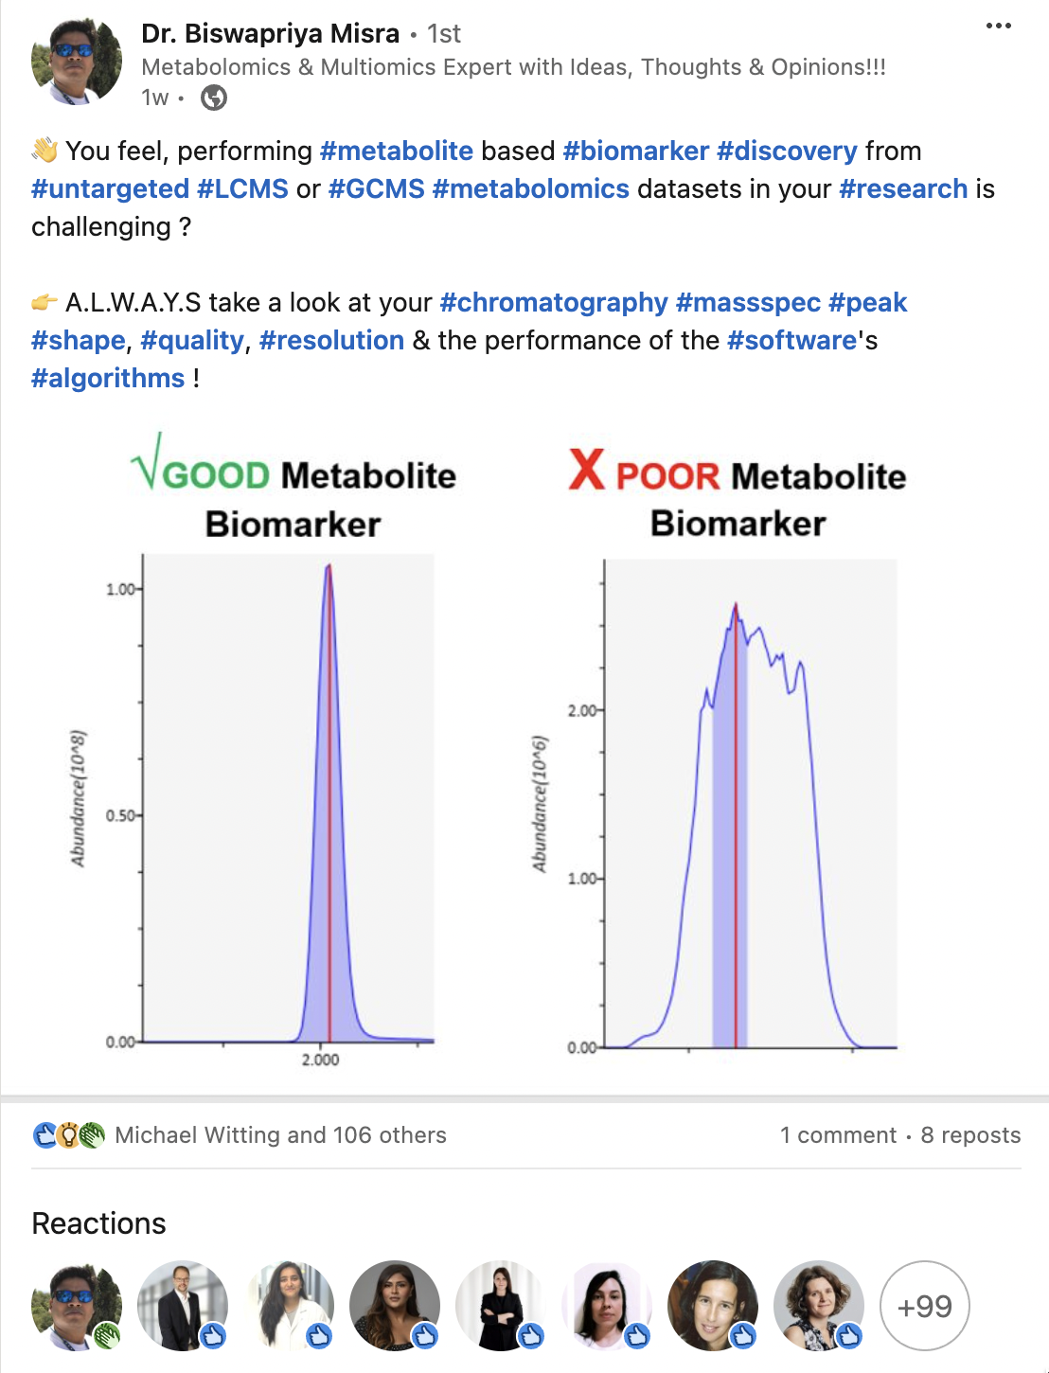
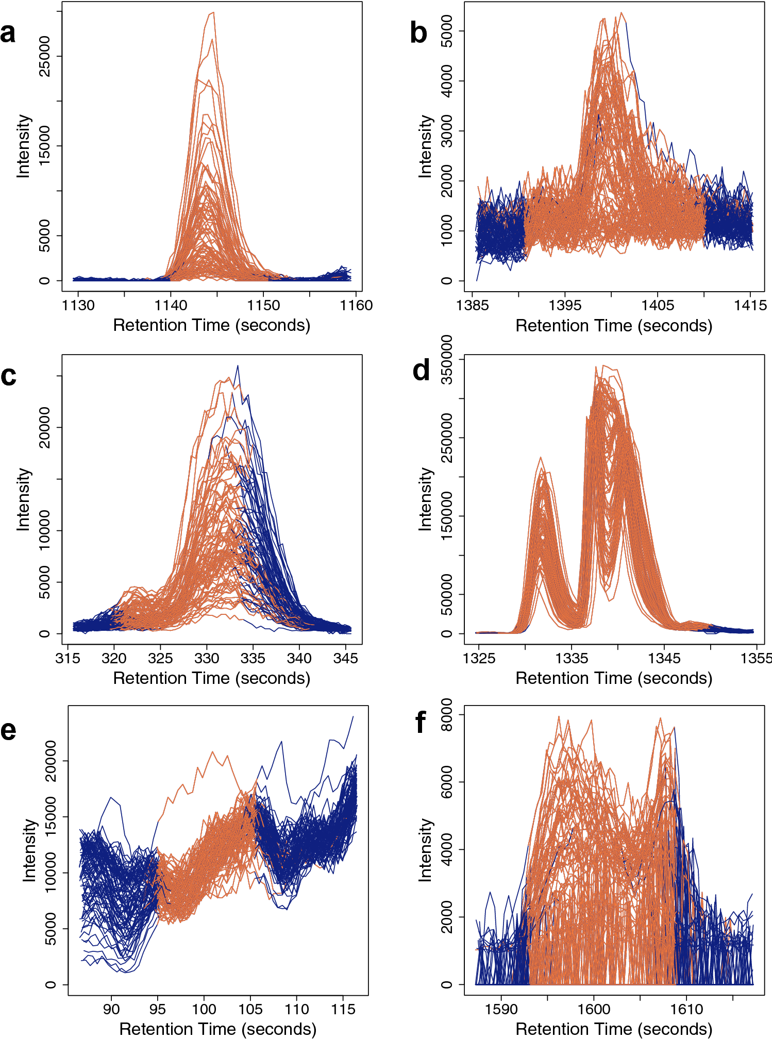
Review peak picking results
Identified Peak
Not part of peak
linkedin.com/in/dr-biswapriya-misra-724ba51aa/
In reality, almost all algorithms will face certain difficulties → manual control
Chetnik, Kelsey, Lauren Petrick, and Gaurav Pandey. "MetaClean: a machine learning-based classifier for reduced false positive peak detection in untargeted LC–MS metabolomics data." Metabolomics 16 (2020): 1-13

Slide 33
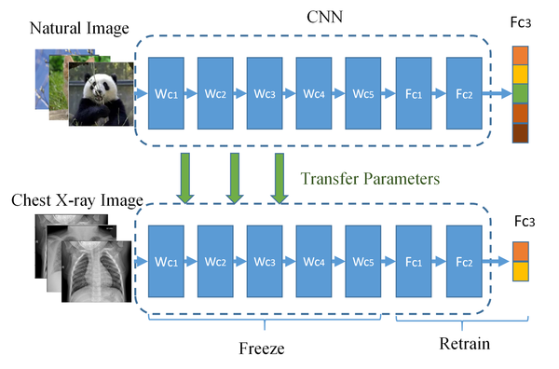

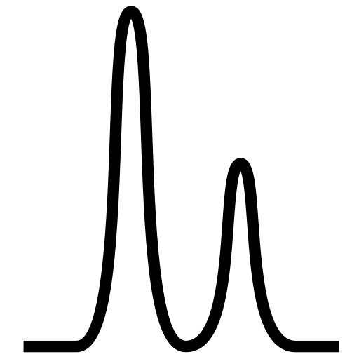

Innovative thinking!
Transfer Image classifiers for peak picking
Peaks as tables of numbers
!! Peaks are images !!
m/z | RT | i
… | … | …
824.5449 | 17.06 | 11000
824.5447 | 17.08 | 27500
824.5445 | 17.09 | 17300
… | … | …
Local Maximum Method
Window Search Method
Peak prominences
Gaussian Derivative based Method
Continuous wavelet transform (CWT)
AI (KI) methods
Wang, Dingding, et al. "An efficient mixture of deep and machine learning models for COVID-19 diagnosis in chest X-ray images." PloS one 15.11 (2020): e0242535.
Use image algorithm for peak picking?

Slide 34
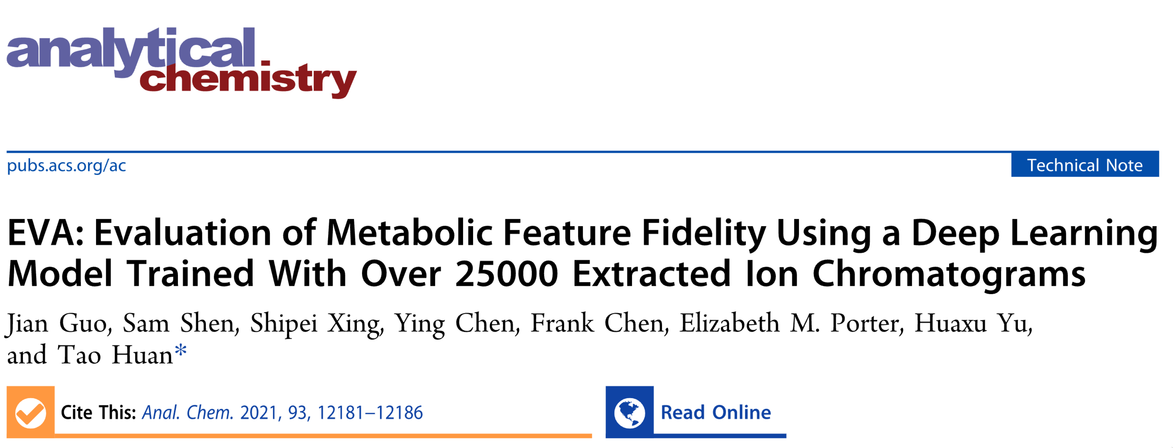
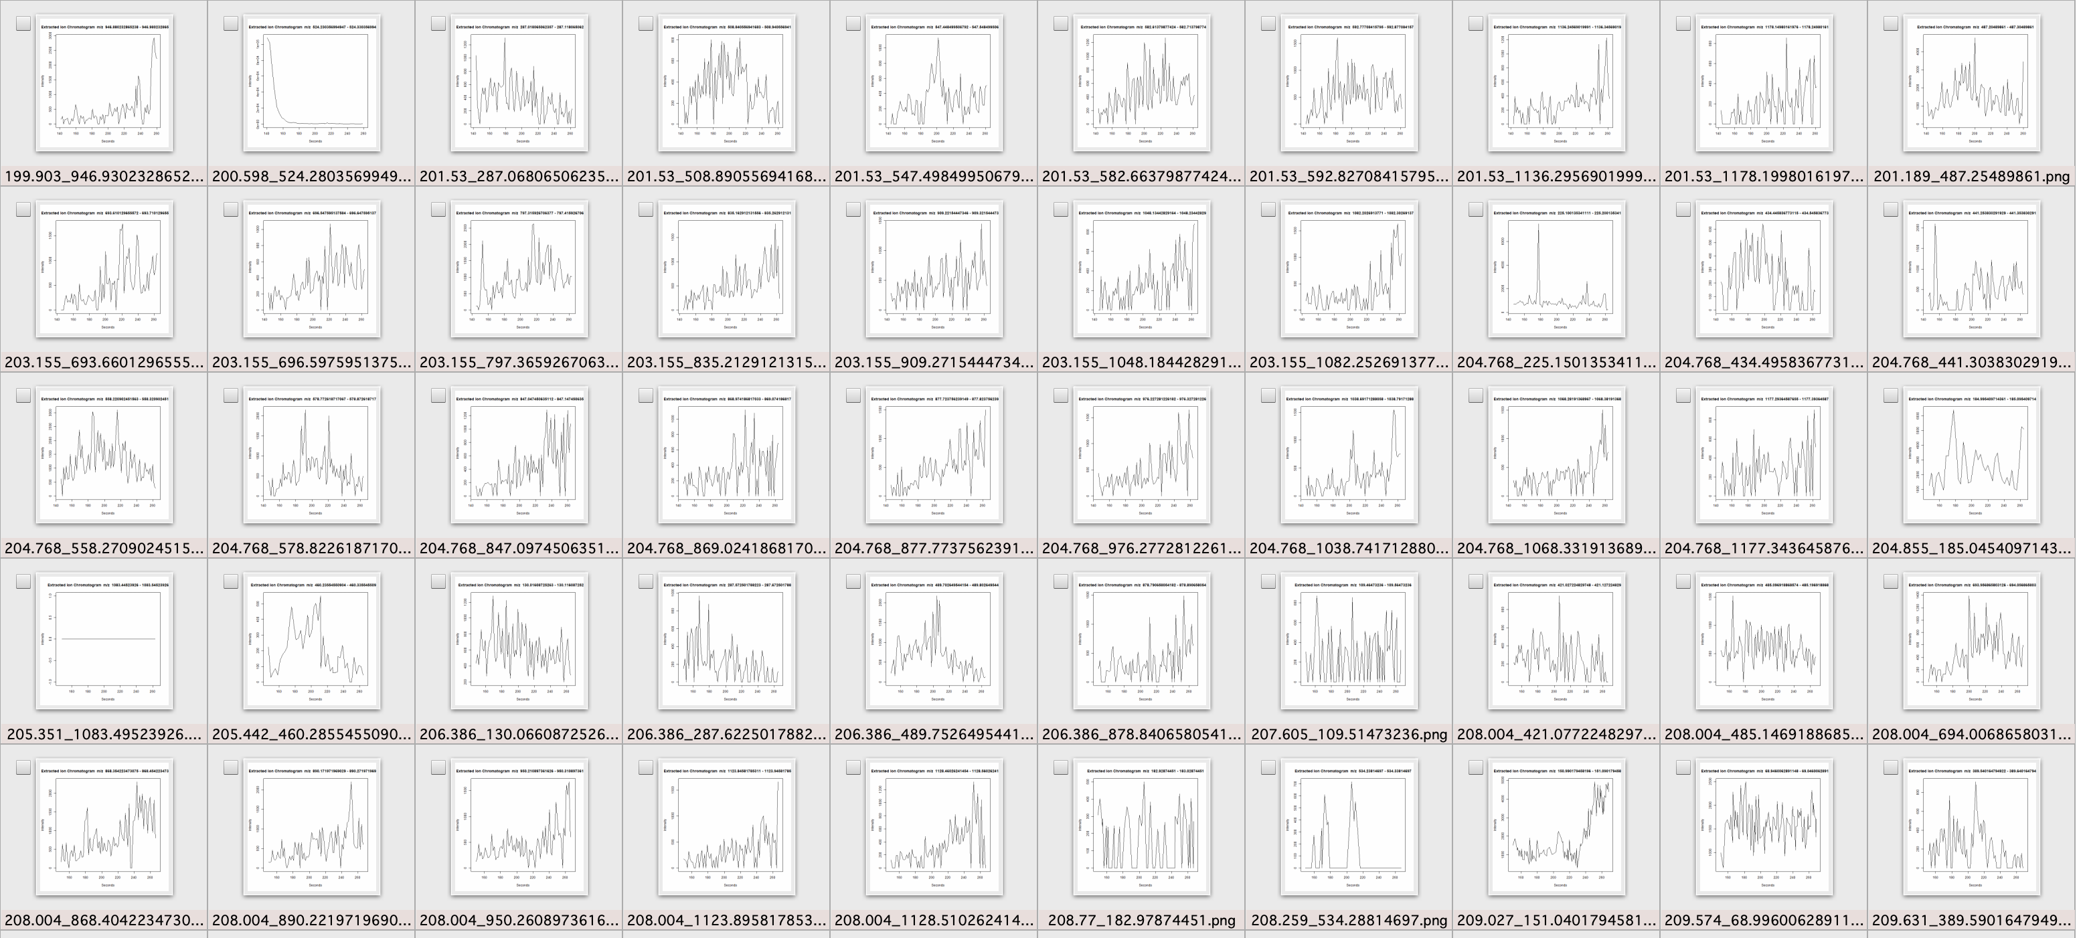
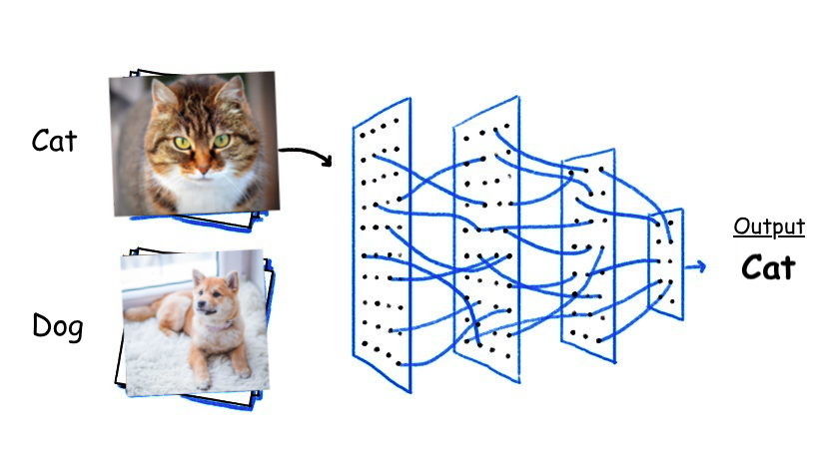
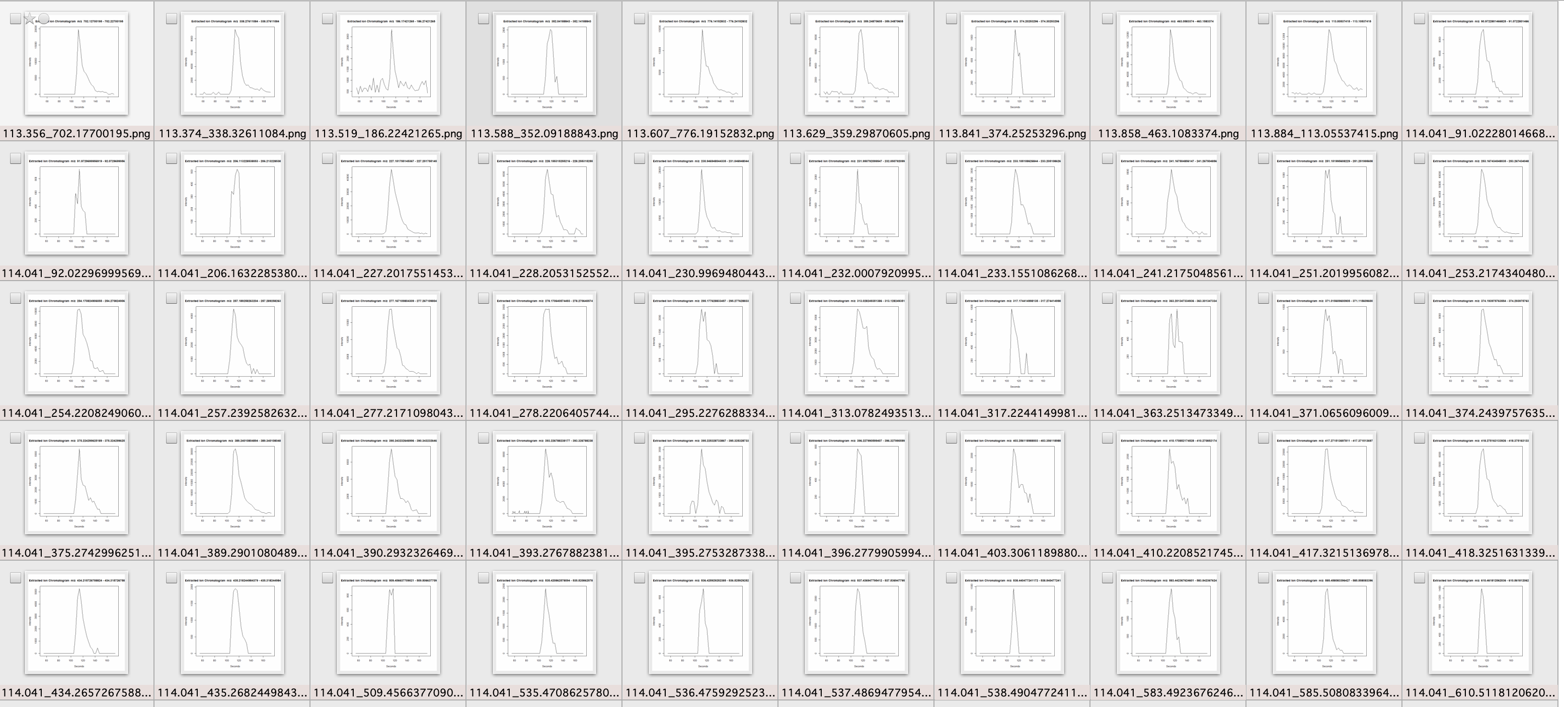
Innovative thinking
Peaks as tables of numbers
!! Peaks are images !!
m/z | RT | i
… | … | …
824.5449 | 17.06 | 11000
824.5447 | 17.08 | 27500
824.5445 | 17.09 | 17300
… | … | …
False peak
7867 images
True peak
17228 images
Deep Learning methods (AI/KI)
True peak
17228 images
True peak
False peak
7867 images
https://towardsdatascience.com/10-papers-you-should-read-to-understand-image-classification-in-the-deep-learning-era-4b9d792f45a7
Guo, Jian, et al. "EVA: evaluation of metabolic feature fidelity using a deep learning model trained with over 25000 extracted ion chromatograms." Analytical Chemistry 93.36 (2021): 12181-12186

Slide 35




Take home messages
XIC @ m/z
The LC-MS XIC: the Intensity changes over Time for defined mass/charge ratio (m/z)
Different peaks in LC-MS XIC → Quantify different molecules (with same formula)
Raw data needs preprocessing → baseline corrections, curve fitting, smoothing, …
Peak picking has many different algorithms
Gaussian Derivative, Continuous wavelet transform (CWT) , 2D/3D methods, and more + AI(KI) methods
Gaussian Derivative based algorithms
1st derivative + zero crossing
2nd derivative
Manual revision
Peak apex & Peak boundries
B
A
PeakBot model
1st
2nd
2nd
@Zhixu_Ni
github.com/ZhixuNi/PeakPickingLecture
Algorithmic Concepts of Peak Picking © 2024 by Zhixu Ni is licensed under
Creative Commons Attribution-NonCommercial-ShareAlike 4.0 International
Download slides

Slide 36
LC-MS peaks for isomer detection
C
7.05E3
279.23
C₄₅H₇₉NO₁₀P⁻
100
A
NL: 8.12E5
15.26
XIC m/z 824.54
100
C₄₅H₇₉NO₁₀P⁻
80
277.23
764.52
60
90
Relative Abundance
311.43
618.62
Different peak in LC
Different compound
No structure information
40
337.91
522.67
80
20
0
100
200
300
400
m/z
500
600
700
800
70
9.34E3
303.23
C₄₅H₇₉NO₁₀P⁻
100
B
LC
60
80
60
253.22
764.52
LC-MS peaks → Quantify compounds
Relative Abundance
Relative Abundance
824.54
50
40
568.24
658.37
40
MS
20
B
0
6.19E4
100
200
300
400
m/z
500
600
700
800
30
14.77
Different peak sets in MS2
Different compound
No quantity information
100
301.22
C₄₅H₇₉NO₁₀P⁻
C
20
80
255.23
764.52
A
60
10
Relative Abundance
14.30
40
824.55
0
20
13
14
15
16
17
18
480.31
830.72
Time (min)
0
100
200
300
400
m/z
500
600
700
800
Zhixu Ni, Georgia Angelidou, Mike Lange, Ralf Hoffmann, Maria Fedorova. (2017) Analytical Chemistry, 2017, 89 (17), pp 8800–8807.

